Slide 1
Can health microinsurance serving rural poor populations be financially sustainable? Proving the business case with data from India and Nepal
19th Global Conference of Actuaries, Mumbai
30th January 2018
David M. Dror, PhD, DBA
Chairman & MD, Micro Insurance Academy Executive Director, Social Re Consultancy
Notes:
Recognize Atanu Majumdar and Dr. Nihar Jangle as co-authors. Paper submitted to World Development, still under peer review

Slide 2
Outline
Community-Based Health Insurance
Unique features of the implementation model
Business case of Health Microinsurance
Conclusions

Slide 3
Microinsurance key challenge
Most farmers and most risks are uninsured notwithstanding mandating and subsidies
Negligible voluntary uptake of microinsurance
→To create demand (and supply) where none exists
Notes:
In many OECD countries, the 2 strategies to reach UHC have been mandating (Bismarckian model) and subsidies (Beveridgian model)
In most other countries, these 2 strategies are not implemented effectively and systematically.
The main pain-point is that governments cannot reach people in settings of (poverty and) informality.
Hence, there is no option other than to rely on voluntary and contributory enrolment.
This requires creating conditions to catalyze both the demand and the supply of health insurance.

Slide 4
Community-Based Health Insurance (CBHI) aka Health microinsurance
Health insurance also offered through bottom-up initiatives:
Mutuals, Cooperatives and Community-based Organizations (MCCOs) notably Community-Based Health Insurance (CBHI) plans, also known as “health microinsurance”
CBHI plans
Usually in rural and poor areas in South Asia and Sub-Saharan Africa
At present, CBHIs are by-and-large small organizations
Notes:
Mention that CBHI is the generalized system in Rwanda, and benefitting from government support in certain provinces of Ethiopia.

Slide 5
Scale and Sustainability of CBHI
Hypothesis:
In a regime of zero subsidies and no mandating, CBHI can reach
Scale: Many small schemes could deliver health insurance to large population segments
Sustainability: CBHI plans can reach operational and financial sustainability

Slide 6
Unique features of our solution
Objective:
Voluntary and contributory uptake
Indicator:
High renewal rates: >50%
More women
More marginalized (SC/ST)
Cumulative claims ratios: Health: 69%
Community-based approach
Reduce conflict of interest
Awareness, insurance education, Consensus
Inclusive (no limits by age, gender, prior conditions)
Voluntary and contributory uptake
Profit sharing
Notes:
Community-based approach:
local information and data used to price risk-coverage;
Repeated discussions at local level on priority-setting and package design, considering local provision
local talent to administer various tasks (enrolment, claims processing etc)
Local consensus on welfare-gains to the members is the main driver of demand/enrolment
Local governance reduces conflict of interests and lowers costs.
Insurance education and awareness: Better awareness about the value of insurance raised the likelihood of enrolment and renewal.
Revisions business processes: This requires a revision of the business processes. For crop and livestock the communities are covered through group policies. Enrollment procedures are also simplified, e.g. sharecroppers become insurable through community attestations.
Multi-risk coverage: Households that enrolled for more risk classes were more likely to renew their policies.
Multi-tier underwriting: Different underwriting options for different risk classes depending on what risks can be better managed by the community pool or an external insurer or both jointly.
Value-added services: Complementing risk transfer with risk reduction for more comprehensive risk management. Insured households reported positive effects of these value-added services.

Slide 7
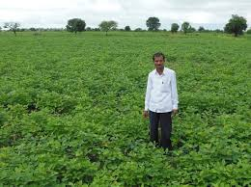
Habitual partner-agent model vs our implementation model
Habitual Partner-Agent Model
Insurance Company (Partner)
Agent / NGO
Product design
Maintenance of long term sustainability
Product marketing
Product servicing
Client
Insurance Company
Our Implementation model
Community: SHGs / farmer groups
Product design
Product marketing
Product servicing
Risk transfer to insurance
Maintenance of long term sustainability
MIA
Technical assistance
Community
Notes:
Not shown in the diagrams: profit taking vs. profit-sharing (premiums do not have profit loading in CBHI; and use of surpluses decided by the members, vs. profit loading and payouts to shareholders)

Slide 8
Ground Structure of CBHI
Federation / Field Partner
CoCo
CoCo
CoCo
CC
CC
CC
CC
CC
CC
CC
CC
CC
CC
CC
CC
CC
CC
CC
CC = Claims Committee → up to 700 households (HHs)
CoCo = Coordination Committee → up to 3,500 HHs
Federation / Field Partner → up to 10,500 HHs

Slide 9
Financial sustainability
Demand
Supply
Scaling
Financial sustainability
Discussed
Addressed
???
Desired
Eliminating barriers to entry: hub solution
Explaining value proposition of insurance
Following peer-to-peer approach
TA to the local mutual scheme to have operational sustainability
Capacity building
Building on informal existing and trusted arrangements and rules-in-use
Def.: Income covers expenditure in full
Not on a year to year basis, but in the long-term
Initial capital required which can be repaid.

Slide 10
Income & Expenditure of
Insurance Operations
Expenditure | Income
Claims | Premium
Operating Costs | Interest on Investment
Cost of Capital | Capital Inflow (Loan / Equity)
CBHIs manage to stabilize claims ratio at 70%.
But what about the Operating Cost ?

Slide 11
Operating Costs
Operating costs in year i (using standard costing methodology):
$$C_{operating,i}= C_{startup,i}+ C_{acquisition,i}+ C_{admin,i}$$
1st year only
Depending on #HHs, renewal rate, costs per facilitator (for outreach)
Depending on #HHs, annual costs per CC, CoCo, Federation
Decrease from year 1 to 5, then stabilize

Slide 12
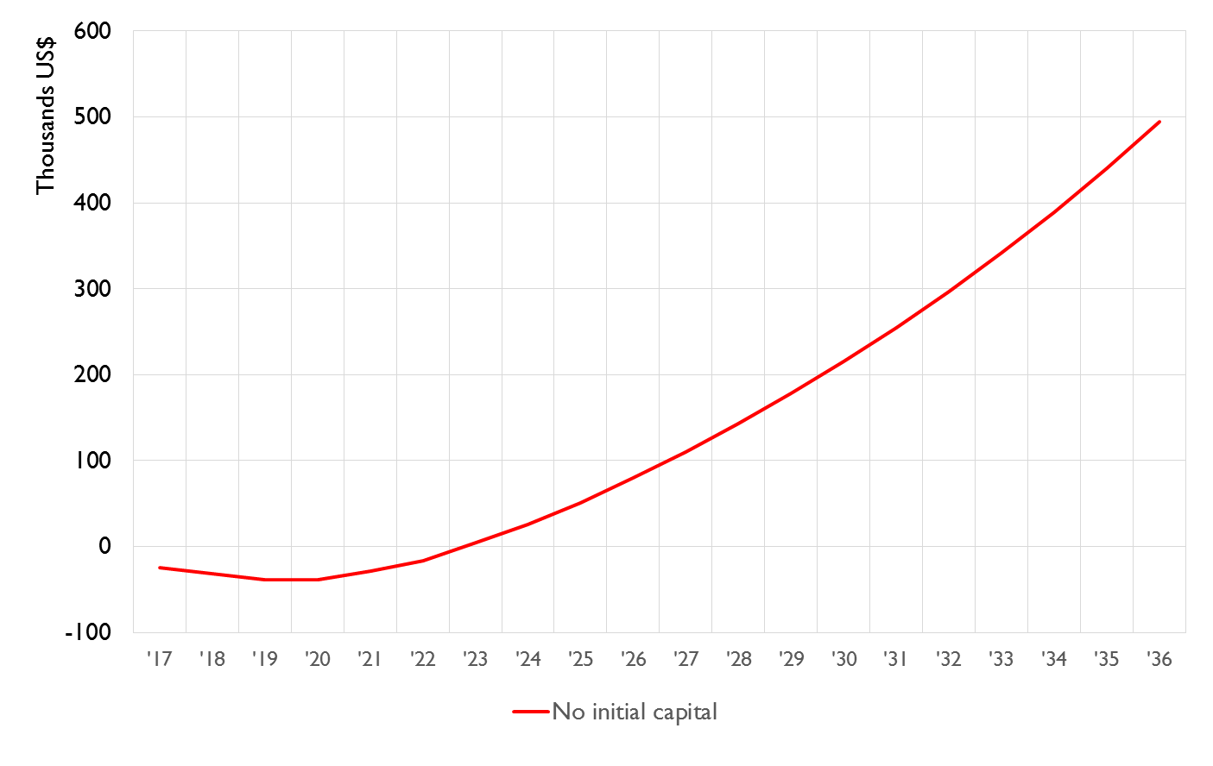
Why does a scheme fail ?
Closing Operating Balance in ‘000 US$
Notes:
Slide 12, 13, 14, 15: The red line represents the balance of income minus expenditure (Closing Operating Balance).
It is written along the y-axis.
The same line has been shown as a green broken line. When the operating balance is negative (shown below the x axis) has been marked with red dashes. The essence of slide 15 is that we have to shift the line above x-axis to make the scheme viable.

Slide 13
Why does a scheme fail ?
Closing Operating Balance in ‘000 US$
DANGER PERIOD
Notes:
Slide 12, 13, 14, 15: The red line represents the balance of income minus expenditure (Closing Operating Balance).
It is written along the y-axis.
The same line has been shown as a green broken line. When the operating balance is negative (shown below the x axis) has been marked with red dashes. The essence of slide 15 is that we have to shift the line above x-axis to make the scheme viable.

Slide 14
Why does a scheme fail ?
High per-capita initial operating cost
No contingency reserve for fluctuating claims ratio
Slow enrolment in the initial years
Closing Operating Balance in ‘000 US$
DANGER PERIOD
Notes:
Slide 12, 13, 14, 15: The red line represents the balance of income minus expenditure (Closing Operating Balance).
It is written along the y-axis.
The same line has been shown as a green broken line. When the operating balance is negative (shown below the x axis) has been marked with red dashes. The essence of slide 15 is that we have to shift the line above x-axis to make the scheme viable.

Slide 15
Survival Strategy:
Infusion of Initial Capital
Closing Operating Balance in ‘000 US$
Notes:
Slide 12, 13, 14, 15: The red line represents the balance of income minus expenditure (Closing Operating Balance).
It is written along the y-axis.
The same line has been shown as a green broken line. When the operating balance is negative (shown below the x axis) has been marked with red dashes.
The essence of this slide is that we have to shift the line above x-axis to make the scheme viable.

Slide 16
Total capital requirement
Total capital requirement T_{i} in year i:
$$T_{i}= C_{operating,i}+{(μ}_{i}+ σ_{i}∙ Z_{0.999})∙\#enrolled persons$$
Claim Reserve
$$μ_{i}=\text{expected} \text{payout} \text{per} \text{person} \text{in} \text{year} i$$
$σ_{i}= \text{standard} \text{error} \text{of} \text{mean} \text{of} \text{payout} \text{per} \text{person} \text{in} \text{year} i$
$$Z_{0.999} \text{is} \text{such} \text{that} \text{Prob} \{ X ≤ Z_{0.999} | X\sim N(0,1)\}=0.999$$
Notes:
Slide 16: what is the meaning of the expression Z0.999
Z0.999 is the point to the right side of which the probability is 0.001 under standard normal distribution.
The key point is: Claim Reserve is such that chance bankruptcy is one in 1000.

Slide 17
Loan requirement
Operating results:
$$B_{i} + P_{i}+ M_{i}+ I_{i}= C_{claims.i}+C_{operating, i}+ L_{i}+ B_{i+1}$$
$$B_{i}=\text{operating} \text{balance} \left(\text{opening}\right) \text{at} \text{the} \text{beginning} \text{of} \text{year} i$$
$$M_{i}=\text{loan} \text{taken} \text{at} \text{the} \text{beginning} \text{of} \text{year} i$$
$$I_{i}=\text{interest} \text{earned} \text{in} \text{year} i$$
$$C_{claims,i}=\text{aggregated} \text{claim} \text{costs} \text{in} \text{year} i$$
$$L_{i}=\text{loan} \text{repayment} \text{in} \text{year} i$$
$P_{i}$ = total premium income in year $i$
Need for loan arises when, total capital requirements exceed operation balance plus total premium income:
$$T_{i}>B_{i}+P_{i}$$

Slide 18
Loan and repayment installments
Loan options:
Entire loan taken at outset
Minimum loan taken in each year so that CBHI plan stays solvent
Repayment installment options:
Constant or incremental repayments
With or without moratorium
Max repayment installments each year so that solvency is still guaranteed

Slide 19
A Prototype
Year | # Individuals insured | Premium Per Capita in US$
1 | 2,800 | 5.11
2 | 6,300 | 5.30
3 | 10,500 | 5.51
4 | 16,800 | 5.72
5 | 24,500 | 5.95
6 | 30,240 | 6.19
7 | 36,750 | 6.45
8 | 38,000 | 6.73
9 | 39,000 | 7.01
10 | 40,000 | 7.31
11 | 40,000 | 7.62
12 | 40,000 | 7.94
13 | 40,000 | 8.29
14 | 40,000 | 8.65
15 | 40,000 | 9.03
If
the given trajectory of number of individuals insured and premium per capita per year is achieved
Repayment in Equal Annual Installment
In 10 years
After a moratorium of 5 years

Slide 20
Amount of Loan
Year | Capital Required in the beginning of the year (US$) | If total funds come at one go at the start of the scheme (US$)
1 | 31,703 | 62,477
2 | 12,712
3 | 12,954
4 | 6,178
Capital Required to provide permanent insurance cover to an individual
= US$ 62,477/40,000 = US$ 1.56
Notes:
Slide 20: when the sums are added up the balance is $63,547, not $62,477.
This is not discrepancy. If funds come at the beginning of every year then total will be $63,547. If the total funds come together in the beginning of the first year, then amount will be $62,477. Stated otherwise, this is the present value of the fund flows given on the left side at the rate of interest 8% pa.

Slide 21
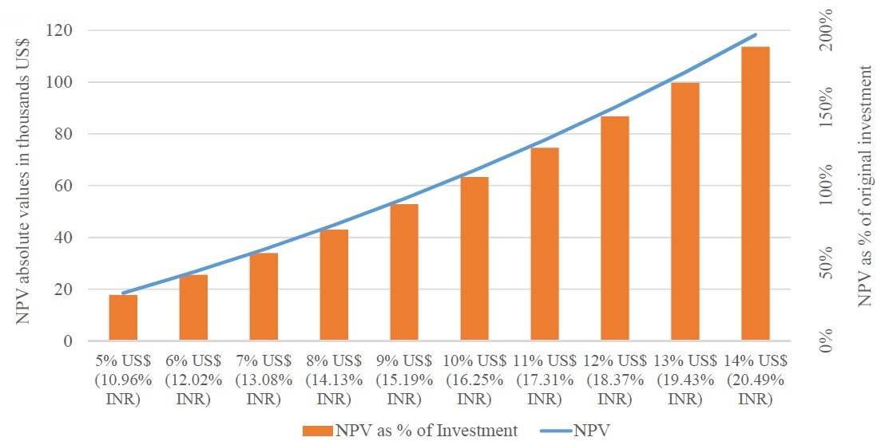
Can CBHI Pay Interest ?
What is the NPV of Investment?
Notes:
Slide 21: The net present value (NPV) refers to which amount of investment?
$62,477, and the % of NPV of investment depends on the difference between two interest rates: interest rate given by the borrower and interest rate if invested on safe Treasury bond. We assumed a treasury rate of 2.365% per annum for discounting the repayment installments. 2.365% is the average of two rates given below:
(1) 20 Year Treasury Rate: 2.58% for Nov 10 2016
(2) 10 Year Treasury Rate: 2.15% for Nov 10 2016
Source: https://ycharts.com/indicators/10_year_treasury_rate
While computing the present value we have discounted the annual installments by 2.365% per year. But the installments were calculated based on varying interest rates starting from 5% to 14%.
If the interest rate is 14% (given by CBHI), the annual installment for a loan of $62,477 is $23,062 from 6th to 15th years (5 years’ moratorium). Present value of all repayment installment is $180,836. NPV = $180836-$62,477 = $118,359 which is 189% of $62,477

Slide 22
Can CBHI Pay Interest ?
What is the NPV of Investment?
CBHI can pay up to 14% per annum in $ (a higher interest puts the CBHI in the red)

Slide 23
Findings: Sustainability parameters
#enrolled HHs
Average #insured members from each HH
Renewal rate
Premium per person per year (PPPY)
Excess of premium over claims ratio (1 minus claims ratio)

Slide 24
Findings: CBHI sustainability
#HHs needed for sustainability (claim ratio assumed to be 70%, renewal rate = 0%)
Average #insured from each HH | Premium levels (PPPY)
 | US$4.48 | US$4.93 | US$5.98 | US$7.47
4.0 | 4,700 HHs | 3,900 HHs | 2,250 HHs | 1,600 HHs
3.5 | 8,000 HHs | 5,200 HHs | 3,650 HHs | 1,850 HHs
3.0 | Never | 9,350 HHs | 4,700 HHs | 2,450 HHs
2.0 | Never | Never | Never | 9,200 HHs
#HHs needed for sustainability (claim ratio assumed to be 70%, renewal rate = 50%)
Average #insured from each HH | Premium levels (PPPY)
 | US$4.48 | US$4.93 | US$5.98 | US$7.47
4.0 | 4,400 HHs | 3,700 HHs | 2,000 HHs | 1,550 HHs
3.5 | 7,150 HHs | 4,600 HHs | 2,500 HHs | 1,800 HHs
3.0 | Never | 7,950 HHs | 4,450 HHs | 2,350 HHs
2.0 | Never | Never | Never | 7,950 HHs
Notes:
This is true for any year if inflation is 0. If operating cost is inflated, the premium PPPY too, has to be inflated at the same rate.
Now what should be the critical values of the five parameters that will bring sustainability to a scheme?
If the claim ratio is stabilized at 70%, sustainability depends on the operating cost. The scheme has to manage the operation with 30% of the premium. The cost of operation depends on the number of households enrolled and renewal rate but relationship is not linear. There is no “one single solution” for the sustainability. Various combinations of these five parameters can be a feasible solution for sustainability. Notice, if per capita premium is increased, the scheme needs fewer households to break even. If average number of insured per household is reduced, more households are required to cover the cost. If renewal is high, fewer households will be required.
We have tried to find several combinations of five parameters as feasible solutions for sustainability. The first table assumes renewal rate is zero. The second table assumes 50% renewal rate. The most practical solution (based on our experience) is (MOVING TO THE NEXT SLIDE)
Claim Ratio 70%, Renewal rate 50%, Premium per capita US$ 4.93 (INR 330), 4,600 households and average 3.5 insured from each household.
Other schemes may want to reach a different solution. If it is possible to maintain a claim ratio at 60%, sustainability will be achieved with a lesser premium or fewer households or with fewer insured from each household.
Note that, one of the assumptions here is zero inflation. This solution will not be achieved in the first year. Operation cost will increase in the subsequent years. The premium should also increase at the same rate so that the targets for the number of households and average number of insured per household remain unchanged.
Claims Ratio being 70%, benefits will also go up and hence, the community, if otherwise satisfied with the scheme, will probably not mind paying 10% more as premium if cover is also increased by 10%. In commercial insurance, the premium increases every year, but not the benefit.

Slide 25
Findings: CBHI sustainability
#HHs needed for sustainability (claim ratio assumed to be 70%, renewal rate = 0%)
Average #insured from each HH | Premium levels (PPPY)
 | US$4.48 | US$4.93 | US$5.98 | US$7.47
4.0 | 4,700 HHs | 3,900 HHs | 2,250 HHs | 1,600 HHs
3.5 | 8,000 HHs | 5,200 HHs | 3,650 HHs | 1,850 HHs
3.0 | Never | 9,350 HHs | 4,700 HHs | 2,450 HHs
2.0 | Never | Never | Never | 9,200 HHs
#HHs needed for sustainability (claim ratio assumed to be 70%, renewal rate = 50%)
Average #insured from each HH | Premium levels (PPPY)
 | US$4.48 | US$4.93 | US$5.98 | US$7.47
4.0 | 4,400 HHs | 3,700 HHs | 2,000 HHs | 1,550 HHs
3.5 | 7,150 HHs | 4,600 HHs | 2,500 HHs | 1,800 HHs
3.0 | Never | 7,950 HHs | 4,450 HHs | 2,350 HHs
2.0 | Never | Never | Never | 7,950 HHs

Slide 26
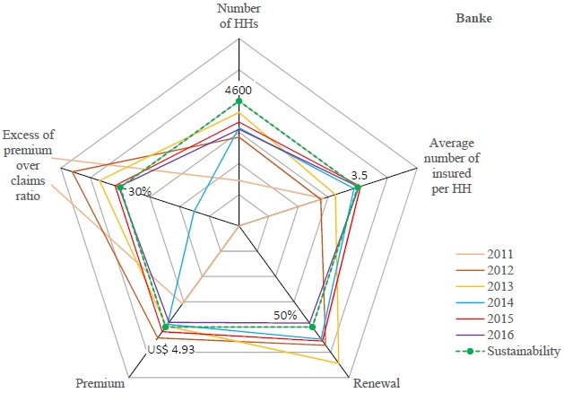
5 Sustainability Parameters for Banke, Nepal, CBHI Scheme
Notes:
The spider graph for Banke shows six years (2011-2016) of results. Each year has been represented by a colour. The green broken line represents the sustainability line (based on what has been said with the previous slide). Notice that Banke has achieved the sustainability points several times against four of the five parameters (could not achieve the target for the number of households).

Slide 27
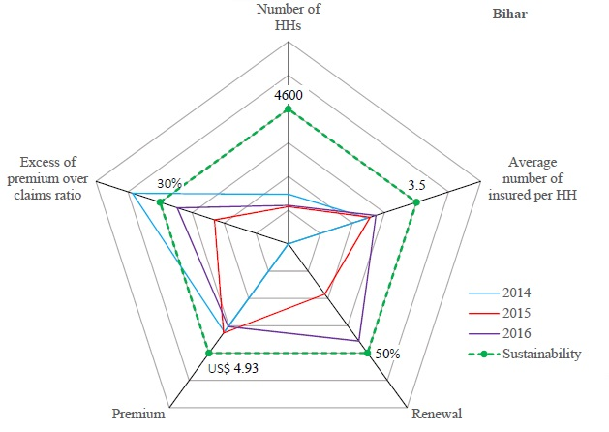
5 Sustainability Parameters for
Bihar, India, CBHI Plans
Notes:
Spider graph for Bihar shows three years of results. Even within three years it has achieved the target against one parameter (claim ratio) at least once. Banke results prove that given time, it is possible to achieve the sustainability solution.

Slide 28
Projected trend: Operation cost
Breakeven: Operating costs are low enough to be covered by excess of premium over claims
Accumulation of community assets
Sustainability parameters:
# Enrolled HHs
Enrolled members per HH
Renewal rates
Per capita premium
Excess of premium of claims ratio
Notes:
We show descending admin costs, which we assume to plateau at around 20% of the premium as operating cost, and which is reasonable at the MIU level. Because there are CCs, CoCos and admin cost at the Federation level.
And cost will not monotonically decrease with increased enrollment.
When a new CC or CoCo is set up, the number of insured increases, the cost per capita also increases temporarily. For data and the chart in excel please see the Page “Table-4 Prototype” in the attached excel file (Data 15.8….).

Slide 29
Community Assets
Notes:
Community assets (=closing operating balance) depends on the interest rate paid to the investor.
This slide shows the operating closing balance at various interest rates. It also shows that the line representing 15% interest, pass through negative region and hence it is not possible to pay more than 15% interest. The chart is in the page “Fig-9, 10,11_VaryingIntRates” in the attached excel file (Data 15.8….).

Slide 30
Scaling Up
Return on investment | Initial loan = Investment (Million US$) | # Schemes | # HHs (Million) |  | # Individuals (Million)
 |  |  | Year 5 | Year 10+ | Year 5 | Year 10+
up to 14.02% per annum in US$ | 1 | 16 | 0.11 | 0.16 | 0.39 | 0.64
 | 5 | 80 | 0.56 | 0.80 | 1.96 | 3.20
 | 10 | 160 | 1.12 | 1.60 | 3.92 | 6.40
 | 25 | 400 | 2.80 | 4.00 | 9.80 | 16.00
 | 50 | 800 | 5.60 | 8.00 | 19.60 | 32.00
 | 100 | 1,600 | 11.20 | 16.00 | 39.20 | 64.00
Notes:
The number of people per scheme is 40,000. Household 10,000. Capital invest per person is $1.56. This has been mentioned in slide 20.
The table given in this slide comes from excel file (Scaling26Jan16_NJ_AM_2_BMGF) .

Slide 31
Conclusions
CBHI plans need to borrow seed capital, estimated at US$62,477 for a plan launched in 2017 ($1.56 pp).
For every US$1 of capital borrowed at inception, each plan can mobilize US$52 as premium income over 15 years.
Growth trajectory to 40K persons within 10 years and avg 3.5 per HH, with modest premiums (range $5.11 to $9.03 pppy) yield a robust business case for operating CBHI plans under
Voluntary and contributory
Zero subsidies to premium

Slide 32
Contact for follow-up
Dr. David M. Dror
Social Re Consultancy and Micro Insurance Academy
Email: daviddror@socialre.org
A-153, DDA D.S.F., Garhi, East of Kailash
New Delhi 110065 (India)
Tel: +91 11 2622 1377, +91 11 2628 5191
Mobile: +91 99 5820 6633
http://www.microinsuranceacademy.org

