Slide 1
7th Seminar on Enterprise Risk Management
1st September 2023
Hotel Sea Princess, Mumbai
Cyber security, cyber risk and Data Privacy – Changing Landscape and what it means for companies

Slide 2
Kalpesh doshi
All views expressed are personal and does not represent official views of any organization.

Slide 3
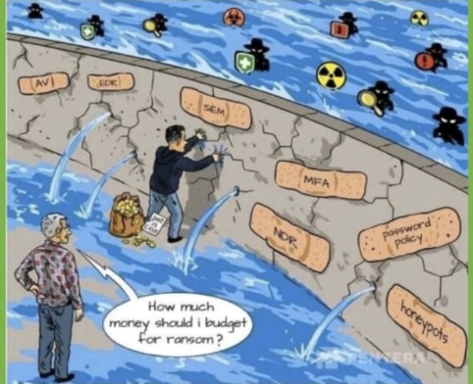
Cyber Security and Cyber Risks
Between June 2018 and March 2022, Indian banks reported 248 successful data breaches by hackers and criminals; the government notified Parliament on Aug 2, 2022
The Indian government has reported 11,60,000 cyber-attacks in 2022. It is estimated to be three times more than in 2019. India has been the target of serious cyberattacks,
Over 300 billion passwords are being used by humans and machines all over the world. (Cybersecurity Media)
Between 2005-2020, there have been 11,762 major security breaches. (ID Theft Resource Center)
The information security market is estimated to reach $170.4 billion by 2022. (Gartner)
Hacking featured 45% of the total breaches, while 17% involved malware attacks and 22% involved phishing attacks. (Verizon)
Cybersecurity risks are increasing day by day, feels 68% of the business leaders (Accenture)
86% of the breaches were financially driven while 10% were motivated by espionage. (Verizon)
88% of companies around the world experienced spear-phishing attempts in 2019. (Proofpoint)
Human errors caused 95% of the total cybersecurity breaches. (Cybintsolutions)

Slide 4
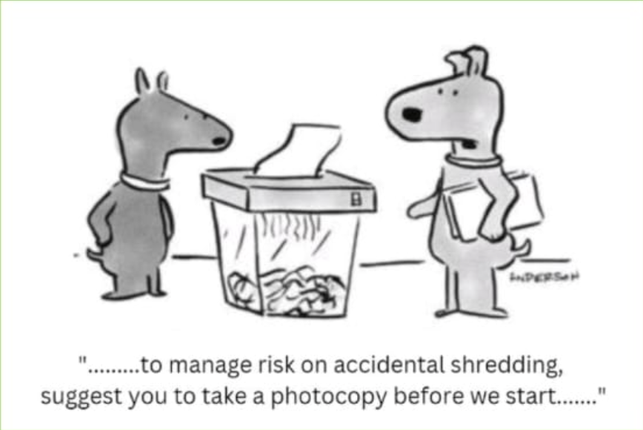
Cyber Risk and Financial Sector
Financial institutions are prime targets for cyber attacks due to the valuable data they hold, including customer information, financial records, and intellectual property.
Cyber attacks can result in significant financial losses for financial institutions, including theft of funds, legal costs, and regulatory fines.
Cyber attacks can damage a financial institution's reputation and erode customer trust, which can result in loss of business and market share.
Financial institutions are subject to regulatory requirements for cyber security, and failure to comply can result in penalties and legal action.
Cyber risk is constantly evolving, and financial institutions need to be vigilant and adaptable to stay ahead of new threats and vulnerabilities.

Slide 5
Significance of Cyber Risk in the Financial Sector
Systemic implications due to interconnectedness of the financial sector entities can amplify disruptions
Financial sector entities especially banks - Are highly leveraged institutions
Preserving public trust is paramount, regulators are concerned about customers data
Business disruptions and IT system failures may lead to erosion of public trust
Blurring of traditional IT frontiers/boundaries due to increasing integration with IT service providers (including those of Cloud)

Slide 6
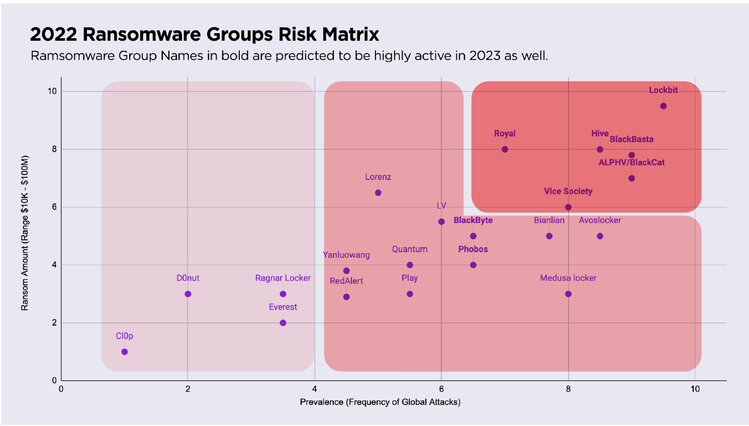
Know your Cyber Enemy (KYCE)
Total estimated ransomware payments in 2022: $27B USD.
Average ransomware payment: $848K USD
Approximate annual increase in ransomware payments: +70%
2022 payments ranged from: $10K - $100M USD
Prevalence determined by both attempted attacks and verified compromises.
Top Ransomware Threats of 2022:
Lockbit
Hive
BlackBasta

Slide 7
Web, Deep Web & Dark Web

Slide 8
All businesses, regardless of size, are at risk. Small businesses may feel like they are not targets for cyber attacks either due to their size or the perception that they don't have anything worth stealing.
Only a small percentage of cyber attacks are considered targeted attacks, meaning the attacker group is going after a particular company or group of companies in order to steal specific data.
The majority of cyber criminals are indiscriminate; they target vulnerable computer systems regardless of whether the systems are part of a Fortune 500 company, a small business, or belong to a home user.

Slide 9
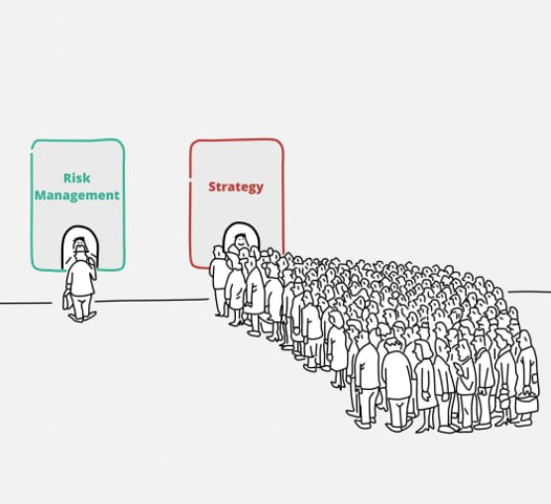
Challenges in Implementing Cybersecurity
Lack of Resources: Implementing a cyber security program requires a significant investment of resources, including time, money, and personnel
Complexity: Cyber security is a complex field, and implementing a comprehensive program can be challenging
Lack of Awareness: Some organizations may not fully understand the importance of cyber security or the risks they face
Compliance Requirements: Many organizations are subject to regulatory requirements related to cyber security, such as those issued by the IRDAI
Emerging Threats: Cyber threats are constantly evolving, and organizations find it difficult to stay up to date with the latest threats and vulnerabilities

Slide 10
You are responsible for Cybersecurity Decisions

Slide 11
THE BOARD’S ROLE IN CYBER RISK OVERSIGHT
5 Principles of Effective Cyber Risk Oversight: Guidance by National Assoc. of Corporate Directors
1
Boards should approach cybersecurity as an enterprise-wide risk management issue, not just an IT issue
2
Boards should understand the legal implications of cyber risk as they apply to the company’s specific circumstances
3
Boards should have adequate access to cybersecurity expertise, and discussions about cyber-risk management should be given regular and adequate time on the board meeting agenda
4
Boards should set the expectation that management will establish an enterprise-wide cyber-risk management framework
5
Board-management discussion about cyber risk should include identification of which risks to avoid, accept, and mitigate or transfer through insurance, as well as specific plans
Source: National Association of Corporate Directors, Cyber-Risk Oversight Handbook, 2020
Notes:
Note: This slide uses the National Association of Directors’ guidance because it is broadly applicable across industry. Chat with your CEO to understand if your Board follows a different set of guidelines, and then change this slide appropriately.
Information Sources:
National Association of Corporate Directors: https://www.nacdonline.org/cyber
U.S. Securities and Exchange Commission: https://www.sec.gov/spotlight/cybersecurity.shtml

Slide 12
Evolution of CISO role
From Technical Expert to Strategic Leader:
From a Reactive to Proactive to Predictive Approach
From a Compliance Focus to Risk Management
From Technology-Centric to Business-Centric
Go beyond technical controls to build a holistic program that protects the enterprise
A successful CISO must be able to build a security culture throughout the organization.
A new posture for cybersecurity in a networked world
Protecting your critical digital assets: not all systems are created equal
Engage the full set of stakeholders to ensure appropriate support and decision-making
The board’s role in managing cybersecurity risks
Ability to translate technical security issues into business risks that are easily understood by board executives.
A framework for improving cybersecurity discussions within organizations
Integrate cybersecurity with business strategy to build trust and create value
How CEOs can tackle the challenge of cybersecurity
Critical resilience: Adapting infrastructure to repel cyberthreats

Slide 13
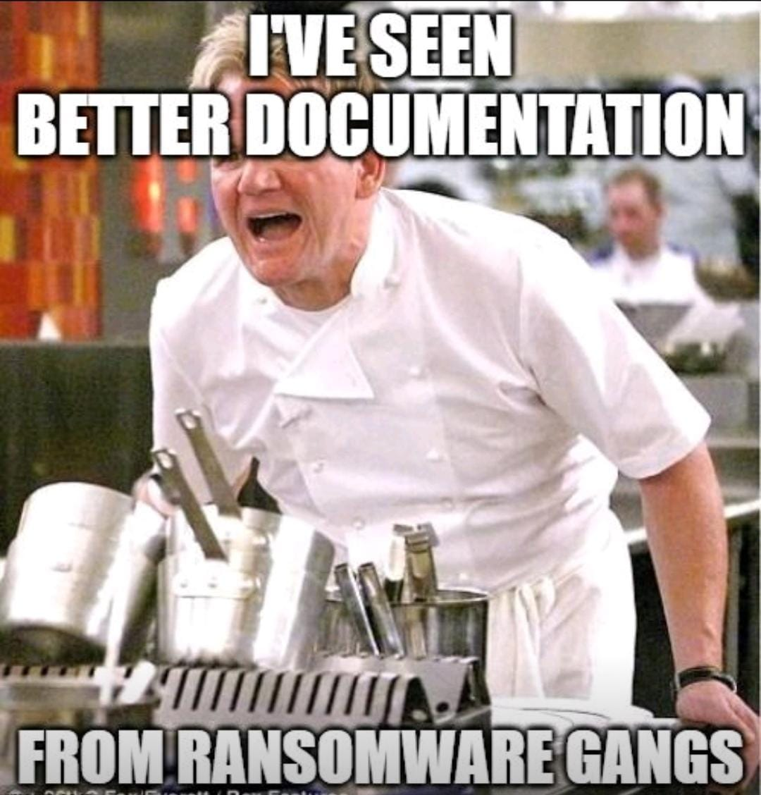
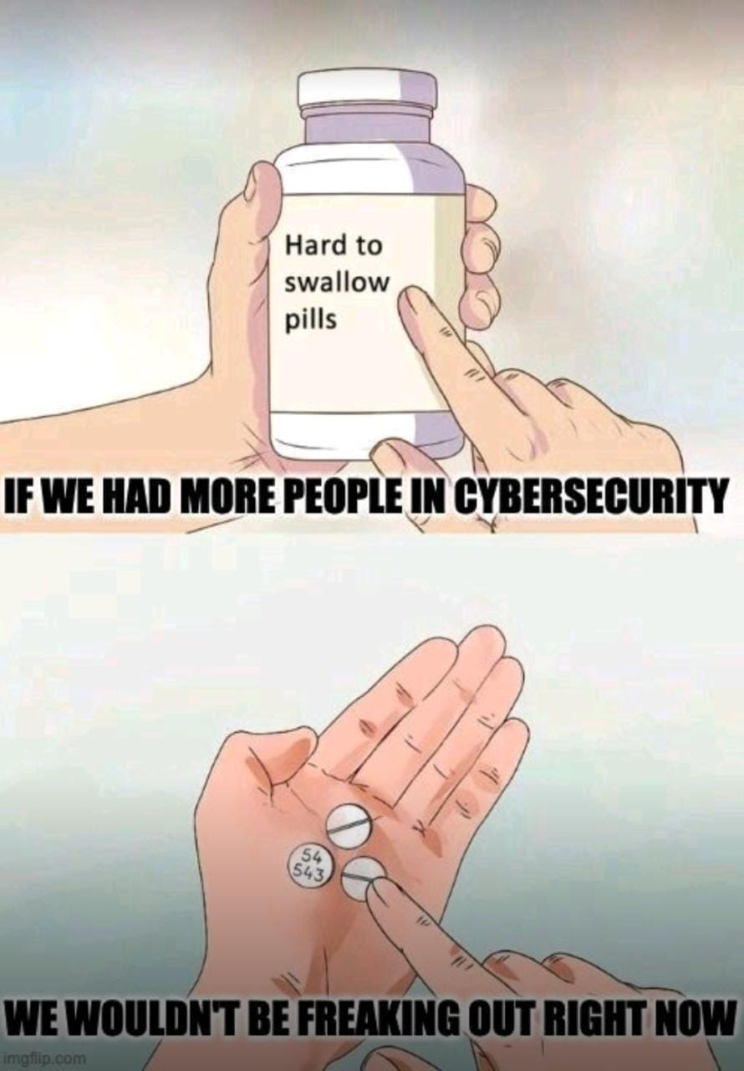
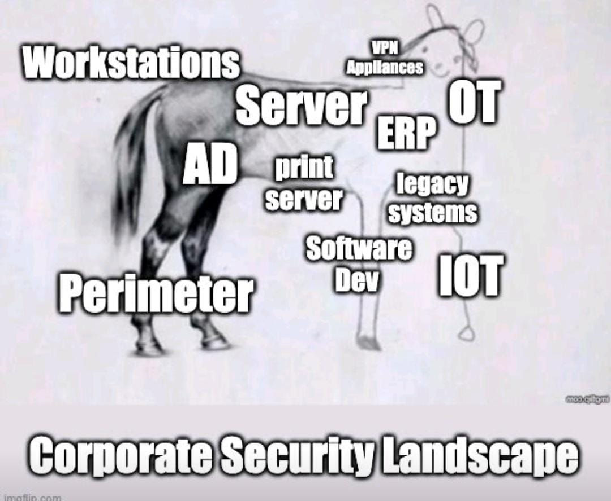
PPT Model

Slide 14
False Sense of Security?

Slide 15
Foundation for Cyber Security
Develop a Comprehensive Cyber Security Program
Provide Cyber Security Training to Employees
Consider 3rd Party Vendor Risk Management as part of your Cyber plan
Invest in your Infosec teams, keep them battle ready
No one tool can protect the organization from cyber adversaries
Develop Incident Response plan, test the plan
Security by Design embed cyber as part of organization culture

Slide 16
Recommended Steps For Securing Your Cloud
t
t
t
Security Governance
Security Assurance
Identity and Access Mgmt
develop and communicate security roles, responsibilities, policies, processes, and procedures
monitor, evaluate, manage, and improve the effectiveness of your security and privacy programs
manage identities and permissions at scale
t
t
t
Threat Detection
Vulnerability Mgmt
Infrastructure Protection
understand and identify potential security misconfigurations, threats, or unexpected behaviors
continuously identify, classify, remediate, and mitigate security vulnerabilities
validate that systems and services within your workload are protected
t
t
Source: AWS Cloud Adoption Framework
Data Protection
Application Security
t
Incident Response
maintain visibility and control over data, and how it is accessed and used in your organization
detect and address security vulnerabilities during the software development process
reduce potential harm by effectively responding to security incidents
Source: AWS Security perspective: compliance and assurance
Notes:
Question to Kalpesh: How important you think the role of Security Governance is in cloud security ?

Slide 17
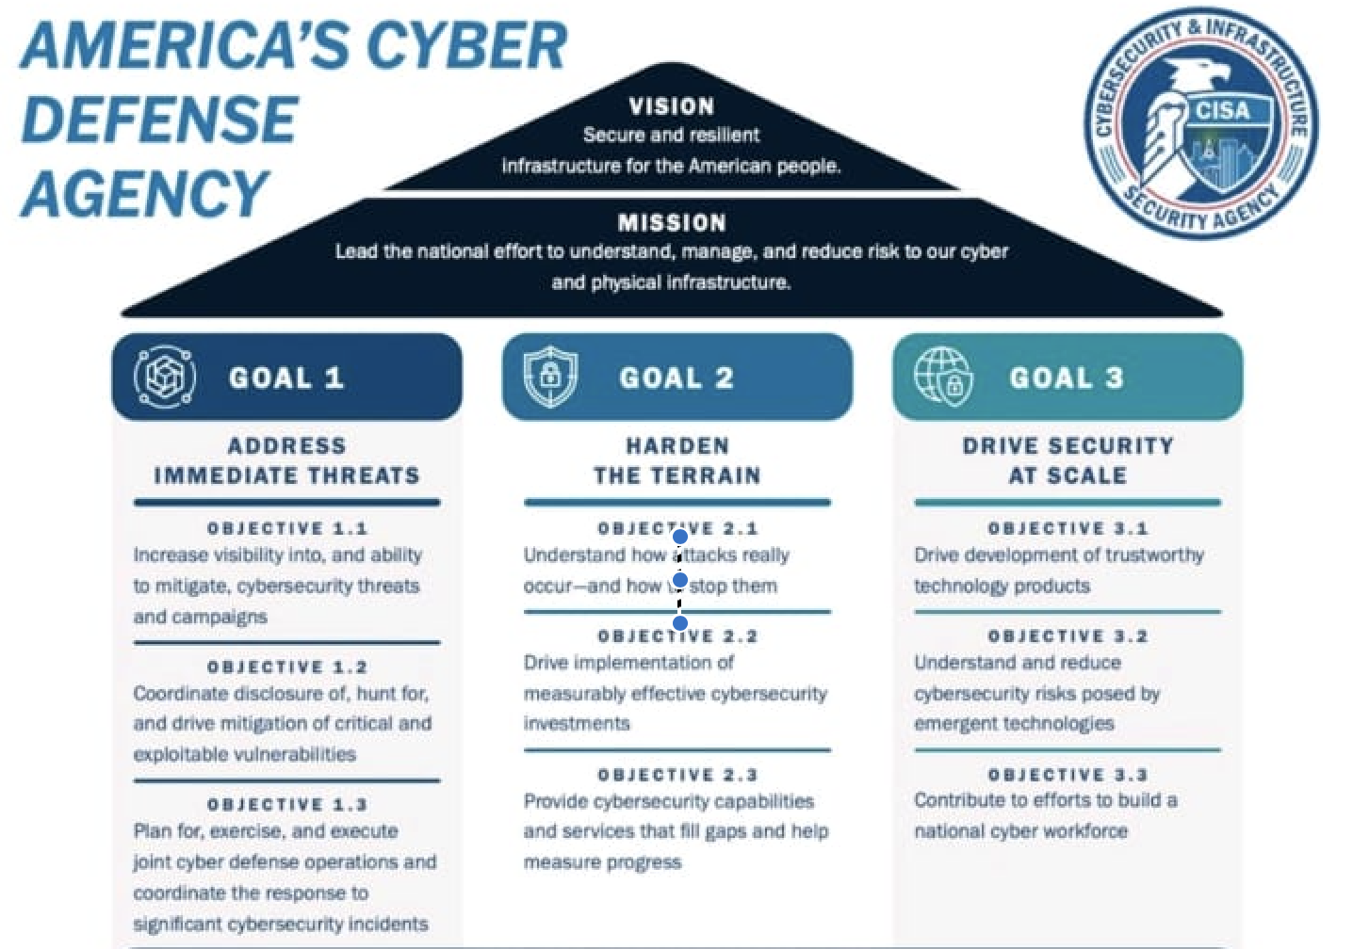
Tips for 2023
The cybersecurity market is expected to grow to $300 billion by 2024.
Global spending on cybersecurity exceeded $1 trillion in 2021.
On average, small businesses spend less than $500 on cybersecurity.
JPMorgan Chase spends $600 million on cybersecurity every year.
The US government’s 2019 budget for cybersecurity is $15 billion.
Every third US company has purchased data-breach insurance coverage or cyber liability insurance.
The cyber insurance market is expected to be worth $20 billion by 2025.

Slide 18
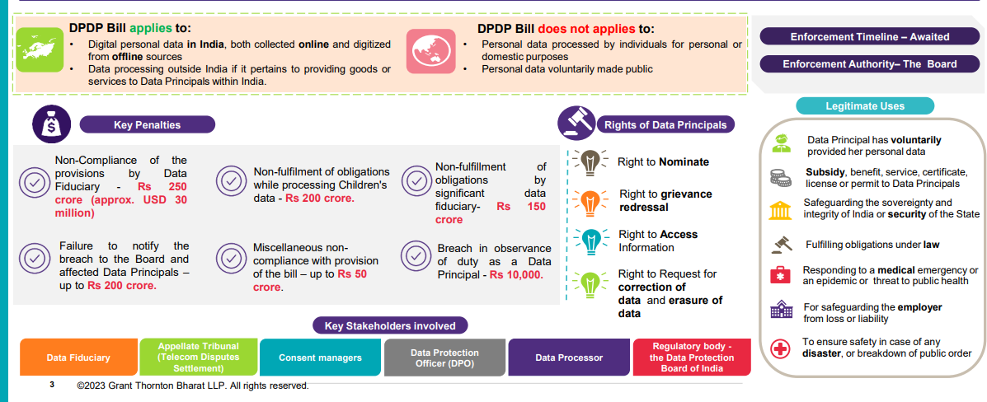
Privacy Bill - overview

Slide 19
Next Steps : Key Actions
Privacy Governance
Establish a privacy governance with cross functional expertise in risk, legal, compliance, technology and create/ update Privacy Framework
Appoint a DPO based in India, reporting to the board or equivalent committee, for compliance with the proposed Act
Privacy Governance
Data Discovery and Classification
Conduct data discovery to identify PII and different data principals whose data is processed within the organization, classify information and identify controls be implemented on the different classes of information as per the proposed regulation
Consent / Notice
Obtain freely given, clear, unambiguous consent for all purposes for which PII is collected. Provide option to withdraw consent.
Provide a notice to the data principal, at the time of collecting data, clearly defining the purpose of processing
Cross border Data Management
Identify the movement of personal data to different jurisdictions and assess the impact as per the regulation
Establish required contracts, data protection measures required to allow the data transfer
Data Principal Rights
Communicate the rights of the data principal through the privacy notice
Establish a process for the data principal to exercise their rights and to respond to the request as per the prescribed timelines
Breach Management
Establish a process to identify personal data breaches and report the same to the Data Protection Board as well as the impacted Data Principals
Vendor/Third Party Management
Identify third parties with whom PII is shared and update relevant data privacy clauses within the contracts.
Conduct periodic assessments on third parties to ensure compliance to privacy requirements
Data Protection Impact Assessment
Establish a process to conduct DPIA on the personal data processing activities and identify risks to the rights of Data Principals
Identify, track and monitor closure of risks identified during the process
Privacy Audits/Reviews
Appoint an External Auditor to conduct periodic privacy audits
Establish process to identify risks, track closure of observations

Slide 20
Sun Tzu on the Art of War
If you know the enemy and know yourself, you need not fear the result of a hundred battles.
If you know yourself but not the enemy, for every victory gained you will also suffer a defeat.
If you know neither the enemy nor yourself, you will succumb in every battle.

Slide 21
Summary
Cybersecurity will require a significant workforce with deep domain knowledge.
Almost everything is hooked up to the internet in some sort of form.
Recent events have widened the eyes of many security experts.
The ability to gain access to high security organizations, infrastructures or mainframes has frightened many people.
Could one click of the mouse start World War III?

