Slide 1
7th Seminar on Enterprise Risk Management
1st September 2023
Hotel Sea Princess, Mumbai
Emerging Risk (Including Business risk in General Insurance

Slide 2
Enterprise Risk Management - non-life insurance
A Perspective

Slide 3
DISCLAIMER
The Document may contain Data/Information on public domain and is provided for informational purpose only. The views presented here are the sole views of the Speaker and doesn’t represent the views of the Organization where he is / was working

Slide 4
References for the Presentation
Emerging risk management for insurers- Wills Re
OECD- Emerging risks for 21 century
Trends Connections and Risk-Argos
WEF_The_Global_Risks_Report_2022
Swiss Re : World insurance: riding out the 2020 pandemic storm
Coforge : Challenges Threatening - Insurance Industry in 2020
PWC-The Future of Risk –Insurance Risk Function of the future
Casualty Actuarial society- 11th Survey of Emerging Risks
EY: 2022 Global Insurance Outlook
Society of Actuaries : 10th Survey of Emerging Risks
KPMG: Emerging Risks in the Global Insurance Industry

Slide 5
Agenda
Proposition : GI Business
Business Complexity and Risk Interfaces
Key Risk Indicator Approach
Emerging Risks : GI Business & Outside in View
Key Regulations & Risks
Notes:
In fact, our lives today are codified by data: almost
everything we do, and everything we depend on,
involves data and the technology that uses it – there
are scant few areas not touched by this revolution
we call the information age.

Slide 6
GI Business Proposition
Touch points conundrum
Sourcing/Solicitation
Servicing-Claims/Policy
Insurer proposition
Limited Touch point with Customer- Back-end Operations
Exposed to Multiple RISK Interfaces

Slide 7
Risk Interfaces-Partners/Vendors/Intermediaries
Insurance Company
Health-Third Party Administrators
Policy Processing Vendors
Software Development vendors
Reinsurers
Garages & Service Providers
IT Infrastructure/Hosting
Agents / Brokers
Insurance Intermediary Tie ups
Break in inspection vendors
Surveyors
Loss Adjusters & Salvage
VAS service providers

Slide 8
Risk Interfaces
Which is the Weakest Link
Break in inspection vendors
Loss Adjusters & Salvage
Collusion with insured and incorrect inspection
Under Reserve assessment
Insurance Company
Health-Third Party Administrators
Policy Processing Vendors
Software Development vendors
Reinsurers
Garages & Service Providers
IT Infrastructure/Hosting
Agents / Brokers
Insurance Intermediary Tie ups
Break in inspection vendors
Surveyors
Loss Adjusters & Salvage
Policy Processing Vendors
Technology Interfaces – Web services integration/ Data Exchange through emails
IT Infrastructure/Hosting Reinsurers
Fraudulent issuance of policy
Vulnerable infra and security ops
Health-Third Party Administrators
Customer Data Leakage from TPA
Garages & Service Providers
Software Development vendors
Invoicing
Claim settlement
Vulnerable application
Business data exposed to internet
Surveyors
Surveyors
Frauds in Survey reports. Collusion with insured
Network Hospitals
Agents / Brokers
Frauds in Survey reports. Collusion with insured
Collusion with TPA and claim leakages
Frauds in policy issuance & Premium

Slide 9
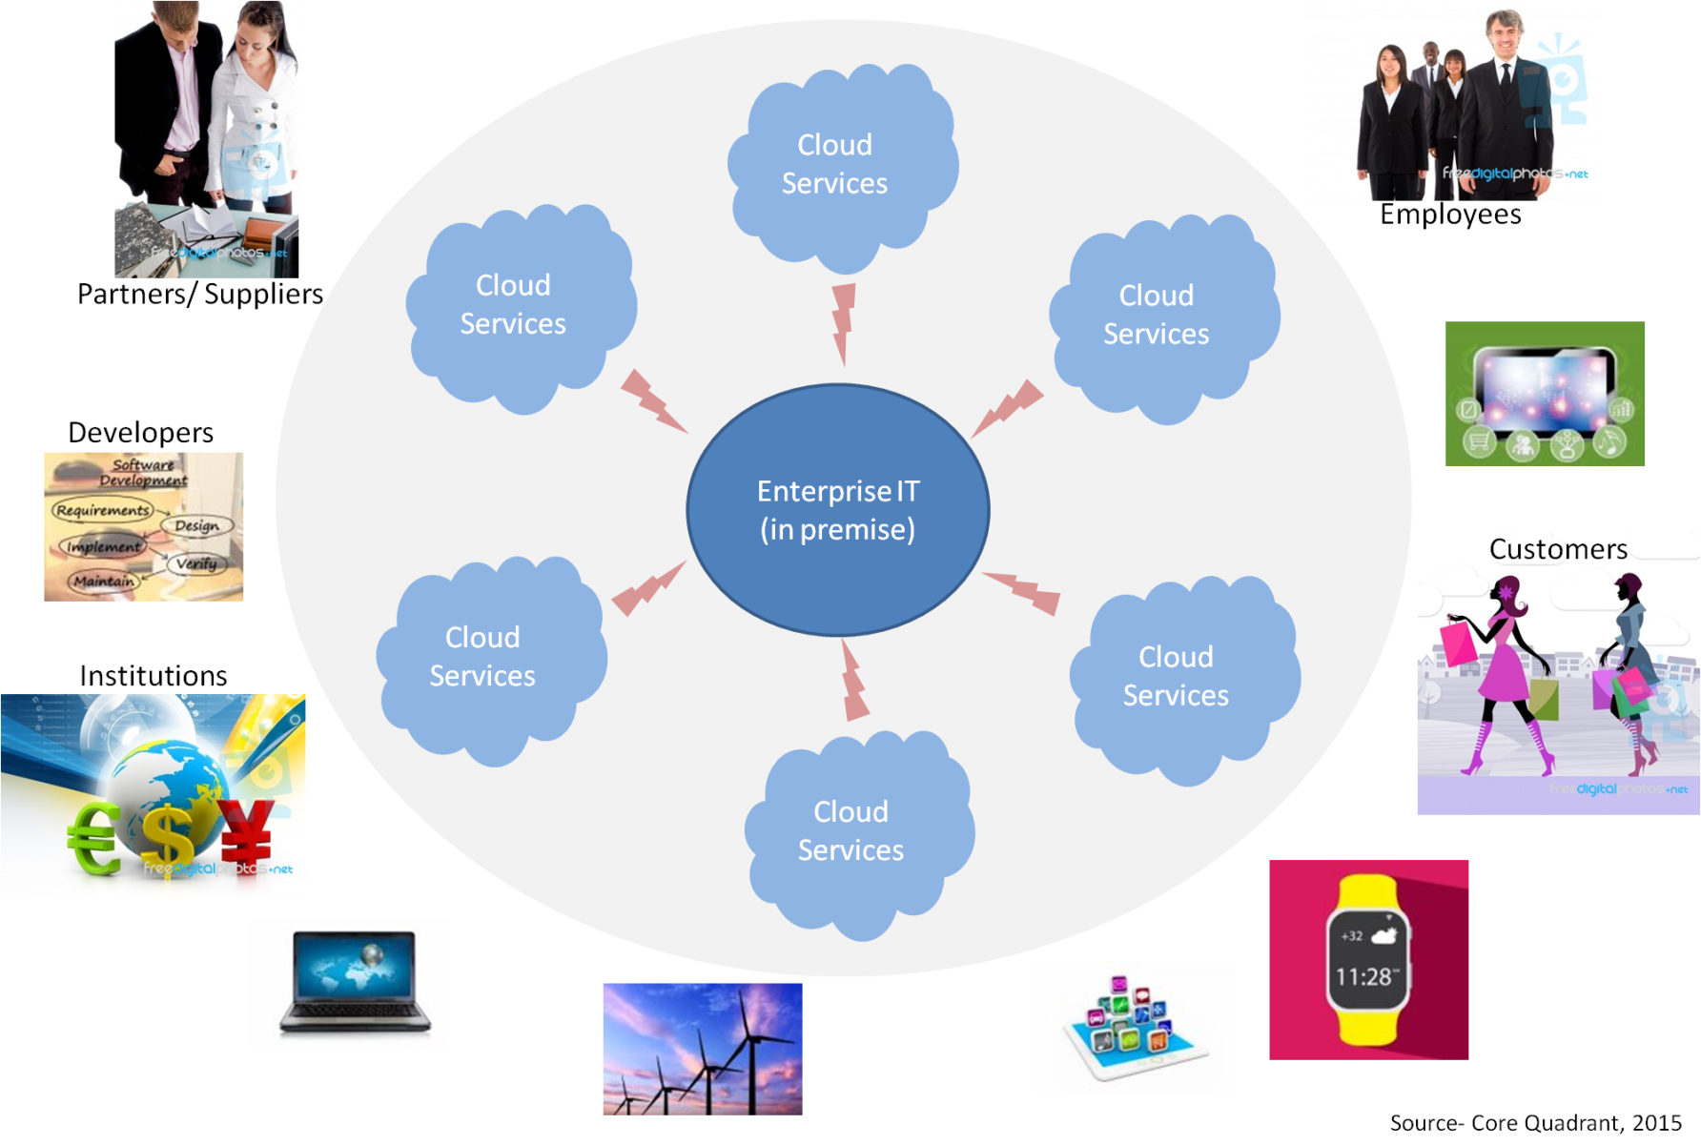
External: Business contextual complexity
Notes:
Let’s see the bigger context, which makes an enterprise digital platform a must.
What was within the enterprise premise (or an extended physical premise) has moved beyond boundaries. The situation has become more complex.
Because
-The traditional IT architecture is challenged by the emerging cloud computing paradigm
-There is a plethora of devices from many access points and on multiple platforms
-Multiple stakeholders, each one with unique ‘interaction requirements’. Enterprise platform is opened for the customers from a customer service or ecommerce perspective.
-Multiple and ever growing applications meeting the unique requirements of the stakeholders
-As a result of multiple devices, users and applications data is exploding, data flow across the enterprise boundaries
-Increasing pressure for speed, compliance, security and governance
The legacy enterprise platform is becoming inadequate to meet the emerging priorities for the CIOs.

Slide 10
Enterprise Risk Management –RAG based Risk Monitoring of KRI’s
Underwriting Risk
Loss Ratio
Concentration
Market & Credit Risk
Investments
Receivables-Credit
Operational Risk
People-Attrition
Process
Reinsurance
Reserving
Large & Cat Claims
Technology
Outsourcing
Strategic
Reputation
Regulatory
Solvency/Capital Adequacy
Plan Achievement
Product Pricing
Interest Rate
Liquidity
Business Continuity
Tax
Information Security
Fraud Control
Retention (customer)
Legal & Contract Management
Litigation Risk
Customer Grievance

Slide 11
Key Risk Indicator Approach
Risk Parameter | Metric | Red | Amber | Green
Financial Risk Profile of Re-Insurers and Domestic Insurers | Domestic Insurers: Solvency Ratio of not less than 1.5 at the time of Placement
 | Re-Insurers: Rating of not lower than __at the time of Placement or During the course of business.
Attrition | Attrition %age - High performers (Employee rated 1 and 2 in performance cycle)
TAT for Resolution of Complaints | % of Complaints resolved within T+7 days (Regulatory TAT of T+15 days)
Value at Risk (VAR) | VAR > %
CAT Risk | Catastrophic Losses
Receivables | Outstanding Receivables (more than 1 year) as a %age of GWP
IT Security Management | Percentage (Number of critical applications not reviewed periodically as per ASLC [Application Security Life Cycle] process
Network Uptime | Uptime of critical network links
Liquidity | Negative Net Operating Cashflows as against investment books

Slide 12
Emerging Risk
Emerging risks are risks which may develop or which already exist that are difficult to quantify and may have a loss potential.
Further, emerging risks are marked by a high degree of uncertainty; even basic information, which would help adequately assess the frequency and severity of a given risk, is often lacking.
Consideration of Emerging Risks is important.
It is a real risk management discipline
Not just staring out the window

Slide 13
Emerging Risk

Slide 14
Snapshot – Industry View
S No | Risk Category | Opportunities & Risk | Risk Velocity
1 | People Risk | Automation of business processes and MIS reporting in Business Operations leading to improvement in productivity and leading to redundant roles in Branch operations | High Velocity
2 | External-Market | Increase in quasi-insurance propositions by OEM or E commerce players. Insurance protection being sold without giving garb of insurance, affecting the insurance penetration. | Medium Velocity
3 | Strategic | DPDP is introducing substantial changes to data protection law and has a big impact on corporates. One of the greatest challenges for organisation is how it maps its technical approach, current technology landscape and capabilities to fulfilling its obligations under PDP. | High Velocity
4 | Underwriting | Impact of climate change on incidence of CAT events. Increased NIC for commercial lines and motor | High Velocity

Slide 15
Snapshot – Industry View
S No | Risk Category | Opportunities & Risk | Risk Velocity
5 | Regulatory | Potential change in regulations wherein license to distribute Health insurance could be provided for life insurance companies | High Velocity
6 | Regulatory | De-tariffing of Motor Third Party (TP) rates | Low Velocity
7 | Strategic | Inability to be a first mover with the digital transformation strategy to gain competitive advantage in distribution, claims and underwriting. Significant increase in share of digital channel. Risk from new digital focused competitors including insurers and aggregators | High Velocity
8 | External Market | Potential risk of reinsurers not extending reinsurance support for the most carbon-intensive companies. This is the direction reinsurers are adopting to manage carbon-related sustainability risks. In the years to come reinsurers would NOT support arrangements for corporations who progressively and demonstrate structured shift away from fossil fuels. | Medium Velocity

Slide 16
Snapshot – Industry View cont…
S No | Risk Category | Opportunities & Risk | Risk Velocity
9 | Strategic | Businesses are facing increasing pressure from society to become purpose-led, delivering value for a broader range of stakeholders, not just their investors. Investors have radically reassessed the importance and value of ESG to their business and investment strategies. There is an increasing scrutiny from regulators and heightened ESG disclosure requirements worldwide | Medium Velocity
10 | Strategic | The risk of cyber-crime is relevant to all businesses. The focus for insurers is to understand how cyber-risks can lead to losses to their operations. | High Velocity

Slide 17
Risks arising from regulatory changes
EOM and Commission Regulations | Description
Old Regulation | Old regulation specifies maximum commission payable and maximum allowable expense by line of business/segmental basis
New Regulation | IRDAI rolled out the new Expense of Management (EOM) Regulations , 2023 on 26th March 23 The regulation stipulates that Insurance Companies need to limit their expenses (Commission + Expenses) to 30% of GWP with additional allowances for certain expenses Single Company level EOM limit without sub limits for commissions and LOB’s
Risk Mitigated | Significant simplification/easier compliance and flexibility for companies to manage their business Risk resulting from tax issues mitigated
Potential Risk Emerged | Risk of increase in commission costs for certain channels
Others Forms of Capital | Description
Old Regulation | Sub-debt allowed up to 25% of Invested Share Capital
New Regulation | Sub-debt to be allowed up to 50% of Invested Share Capital from 25% currently No regulatory approval required for sub-debt issuance if solvency >1.8x
Risk Mitigated | Opportunity to optimize RoE through more efficient capital structure
Potential Risk Emerged | Investment in sub-debt of other insurers to be disallowed for solvency – will shut-off incremental investments in such debt and reduce the universe of potential investors for our sub-debt

Slide 18
Risks arising from regulatory changes
Corporate Agency | Description
Old Regulation | Corporate agents (including banks) are currently able to tie-up with up to 3 insurers each in the General, Life, and Health insurance sectors
New Regulation | Corporate agents (including banks) to be able to tie-up with up to 9 insurers each in the General, Life, and Health insurance sectors for each segment
Risk Mitigated | It will boost insurance penetration towards the regulator's motto of 100% insurance penetration by 2047. It will allow customers to have a wider choice of insurers and products.
Potential Risk Emerged | Expected to increase competitive intensity
Composite License (proposed) | Description
Old Regulation | Life insurance players were not allowed to operate in non-life insurance space and vice-versa Existing regulations allow life insurance companies to offer health benefit/lumpsum schemes but not indemnity products.
New Regulation | Proposal to allow composite licenses ( GI+ LI+ Health) to Insurers by change in Insurance Act
Risk Mitigated | It will help companies achieve synergies of distribution, cost and capital. It will enable companies to sell combi-products enabling them to meet specific customer needs through product innovation.
Potential Risk Emerged | Certain segments of business for e.g. Retail Health may face increased competition Underwriting, products and operations are significantly different for GI & LI; running these contrasting businesses in a single company will be operationally challenging – No successful global examples

Slide 19
Risks arising from regulatory changes
Ind AS 17 | Description
Old Regulation | Current accounting as per IGAAP
New Regulation | IFRS 17 implemented globally from 1st Jan 23 IRDAI likely to implement for Indian insurers over the next couple of years Panel of Insurance companies selected to implement it from FY 25 onwards
Risk Mitigated | Will bring reporting norms for Indian players in line with global peers True picture of profitability as the accounting norms takes into account discounting of liabilities and amortization of cost
Potential Risk Emerged | Complexity in understanding the numbers vs peers Computation complexity Investments in IT system, accounting systems to cater to IFRS requirements

Slide 20
Thank You
Sumedh Jog CFO, Tata AIG General Insurance Company
Satyanandan Atyam CRO, Tata AIG General Insurance Company

