Slide 1
Seminar Name : CIRB
Venue : Mumbai
Date : August 25, 2023
US Pension Plan De-risking and Pensioners’ Journey
Hemant Kumar (Director), Srinivasa Yenugudhati (Senior Manager), Yash Wardhan (Senior Consultant) | Principal Global Services
The information contained in the presentation / video (media) has been taken from public sources as mentioned in the presentation. The views and opinions of the speakers as expressed in the Media, are their individual views and opinions and do not necessarily represent the views and opinions of Principal Financial Group or any of its subsidiaries / affiliates including Principal Global Services Private Limited. The Speakers do not make any representation as to the accuracy, applicability, fitness or completeness of the media content.

Slide 2
Overview
History of US Pension Plans: How did we get here?
Risks and reasons to De-Risk
De- Risking: Options and execution
Insurer’s considerations
Conclusion
www.actuariesindia.org
Notes:
Need to relate it to India??
A Timeline of the Evolution of Retirement in the United States (georgetown.edu)
DB participation from: IF12007 (congress.gov)

Slide 3
History of US Pension Plans: How did we get here?
www.actuariesindia.org

Slide 4
Historical background on US Pension plans
.
Pension Protection Act (PPA):
Higher premiums to PBGC
Increase in tax deductible limit to Pension Plans
Automatic enrollment into DC plans
IRS:
Pension contributions to be tax-deductible. Income on fund's portfolio tax-free
Studebreaker Corporation plan closes down
Plan Participants get 15% of actuarial value of pensions
1900
1921-26
1942
1963
1974
2008
Life expectancy approx. 49 years at birth
Wage and salary act of 1942:
Freeze in wages attempts to contain wartime inflation
Doesn't apply to pension, health and welfare benefits
ERISA:
Disclosure of pension plan details (plan doc, benefit accruals, vesting rules etc.)
Minimum Funding rules
Establishes PBGC
www.actuariesindia.org

Slide 5
Historical background on US Pension plans
Inflation spikes after re-opening post-pandemic
Fed starts increasing rates aggressively
Pension plan assets suffer
Interest rates for liability calculations start rising
Housing Market collapse:
Interest rates nosedive, remain low over the next decade
De-risking conversations become prominent
CARES Act:
Contribution and tax relief for 2020
2008
2012-15
2020
2021
2021-22
MAP21 (2012) – 25-year average for interest rates for pension plan liabilities
HATFA (2014) – Extends use of MAP21 rates
Bipartisan Budget Act (2015)
Extends usage of MAP21 rates
Increases PBGC premium
American Rescue Plan Act (ARPA):
Increases interest rates for liability calculations
Increases amortization period to cover shortfall
www.actuariesindia.org

Slide 6
Risks and reasons to De-Risk
www.actuariesindia.org

Slide 7
US Pension Plans: Risks
Demographic
Regulatory
Longevity
Disabilities
Funding or Disclosure requirements
Administrative expenses
Economic
Other
Fund Performance
Discount rates
Plan Sponsor’s financial health and goals
Global events: Pandemic, Geopolitical events
www.actuariesindia.org

Slide 8
US Pension Plans: Risks
Economic Risks
*Funding valuations use averages of these rates over varying time periods.
DOT-COM Bubble
Housing Market Crash
Inflation and Fed Rate hikes
www.actuariesindia.org

Slide 9
US Pension Plans: Risks
Demographic Risks
Source: United Nations - World Population Prospects
www.actuariesindia.org

Slide 10
US Pension Plans: Risks
Regulatory & Other Risks
PBGC Premiums for Single Employer pension plans
The plan sponsor also bears other administrative costs:
Pension Administration fee
Actuarial and investment services
Pension management fee
Time spent by workforce on plan management
UVB = Unfunded Vested Benefits
VRP = Variable Rate Premium
www.actuariesindia.org

Slide 11
De- Risking: Options and execution
www.actuariesindia.org

Slide 12
De-risking Options
Reduce Risks
Transfer Risks
Plan Amendments
Liability Driven Investments
Pension Risk Transfers (PRT)
Plan Termination
www.actuariesindia.org

Slide 13
Reduce Risks
Plan Amendments: Plan Freeze*
Plan Sponsor could:
Close plan to new entrants
Freeze only future accruals
Freeze all benefits
Continue Employee benefits in a DC plan
Pension Risk Transfer events
Improve funding to DB pension fund
Consider change in asset strategy to LDI
Terminate the plan
*This presentation only focuses on Plan Freeze. In practice, other options are available to plan sponsors. E.g. Cash Balance
Source: PBGC 2020 Pension Insurance Data Tables.
www.actuariesindia.org

Slide 14
Reduce Risks
Liability Driven Investments (LDI)
Pension Plan liabilities behave like high-quality, longer duration bonds
Regular payments like coupons
Low risk of default
Investing in bonds with similar durations to liabilities reduces the interest rate risk/reward since the two behave similarly when rates move
The focus shifts to net return on assets vs. liabilities rather than gross asset returns
Allocation to fixed income increases as funding ratio improves
Duration of fixed income moves toward long duration as funding ratio improves
Hedging characteristics of portfolio increase as the need to take investment risk is reduced
Fixed Income
Return Seeking
www.actuariesindia.org

Slide 15
Transfer Risks
Pension Risk Transfer: Plan Termination
Often use phased De-risking approach: lump sum distributions offered to Terminated participants prior to Plan Termination
Group Annuity contracts purchased for the remaining participants
Lump Sum distributions shift the risks of managing the retirement fund to the employee
Group annuity purchases: plan participants deal with another party for their pensions
Source: PBGC 2020 Pension Insurance Data Tables.
www.actuariesindia.org

Slide 16
Transfer Risks
Lump Sum Window
Estimated incidence Rates of PRT Activity in PBGC - Insured plans
Select Plan participants get the option to take a Lump sum for their plan benefits during a given time period
Reduces administrative costs and long-term PBGC premiums
Lump Sum is an elected form of benefit*
*Plans can directly distribute Lump Sums up to Small Amount Force Out (SAFO). The SAFO limit for 2023=$5,000 and it will be $7,000 in 2024.
TV : Terminated Vested Participants
LS : Lump Sum
Acceptance Rate: Participants of the offer group who opted to take the Lump Sums
Source: PBGC 2020 Pension Insurance Data Tables.
www.actuariesindia.org

Slide 17
Transfer Risks
Example - Lump Sum Offering
IRS 417 (e) Lump Sum Equivalents
$1,000 monthly benefit payable at age 65
 | 2022 Assumptions | 2023 Assumptions | Percentage Drop
Age 45 | $94,000 | $53,000 | 44%
Age 55 | $134,000 | $87,000 | 35%
Age 65 | $191,000 | $150,000 | 21%
Other Assumptions
Single Life annuity form of payment deferred to age 65
2022 results based on Sept. 2021 IRS 417 (e) rates and 2022 unisex mortality
2023 results based on Sept. 2022 IRS 417 (e) rates and 2023 unisex mortality
Calendar year plan with annual stability period
www.actuariesindia.org

Slide 18
Transfer Risks
Group Annuity Purchases
Estimated incidence Rates of PRT Activity in PBGC - Insured plans
Single premium paid to an insurer to transfer part of or entire pension liability
Full plan terminations generally end with a final group annuity purchase for the remaining participants
Even in the case of a full termination, liabilities for actives and deferred vested participants largely settled by lump sum offers prior to a final annuity purchase
Source: PBGC 2020 Pension Insurance Data Tables.
www.actuariesindia.org

Slide 19
Insurer’s considerations
www.actuariesindia.org

Slide 20
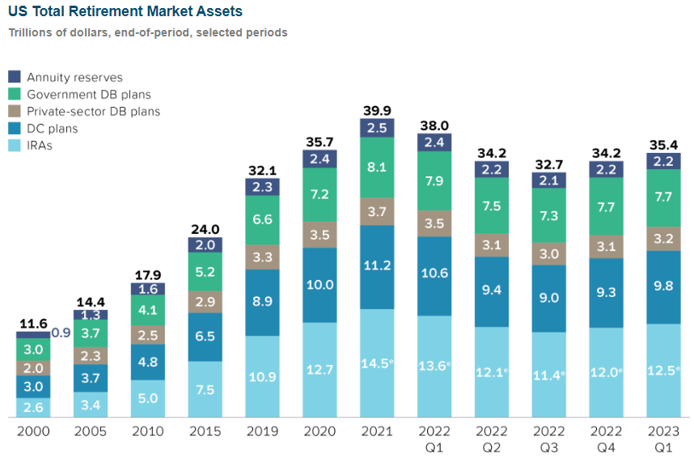
Group Annuity
Group Annuity Purchases – Market Update
Source:Release: Quarterly Retirement Market Data, First Quarter 2023 | Investment Company Institute (ici.org)
Source: LIMRA
www.actuariesindia.org

Slide 21
Group Annuity
Plan Sponsor’s consideration
Tender / Bid Process
Typical timeline, takes 6-18 months (approx.)
Price Considerations
Comprehensive market coverage
Decision not solely based on price
Regulatory guidelines for fiduciary responsibilities
Meet standards of Department of Labor interpretive bulletin 95-1 when selecting an insurance
Participant Communication
Capital and Surplus
Regulatory considerations
www.actuariesindia.org

Slide 22
Group Annuity
Insurer’s consideration
Insurers provided plan specifications and census data. Considerable Q&A on provisions and data issues.
Insurers submit competitive bids for client review.
Annuity vs. PBO (Illustration)
Key Assumptions drive pricing deals
Mortality
Gender, Lifestyle, Occupation etc.,
Need to get mortality right
Plan Feature Utilization
Investment Earnings
Expenses
Reserve & capital
www.actuariesindia.org

Slide 23
Group Annuity
Insurer’s consideration – Emergence of Profit
A PRT case has no recurring premium deposits → Setup a large reserve for future benefits
Initial Capital Loan from Corporate = (STAT Reserve + RBC) – Premium
Return capital to corporate as earnings emerge over time
Key pricing metric is IRR on corporate transfers
www.actuariesindia.org

Slide 24
Conclusion
www.actuariesindia.org

Slide 25
Participant Protection Before/After PRT
DB Plan
ERISA sets funding requirements, authorizes DOL, IRS, PBGC to administer/enforce
Underfunding is common, may fall to as low as 80% before triggering adverse consequences by law
PBGC guarantees benefits up to statutory limits, funded by premiums paid by DB plans
Purchased Annuity
NAIC establishes reserve and investment standards, state regulators enforce
Higher standard for funding – constant solvency regulation requires all liabilities to be funded at all times
State guaranty associations cover failures, funded by licensed (solvent) insurers
Insurers generally have more assets available in failure
Separate accounts have become common to provide further insulation protection in PRT
www.actuariesindia.org

Slide 26
De-risking : Solution Risk Matrix
 |  | Stakeholders | Plan Sponsor | Insurer
 |  | Plan Participant | Plan Sponsor | Insurer
De Risking Solutions | Plan Amendments
 | Liability Driven Investments
 | PRT – Lump Sums
 | PRT – Annuity Purchase
Minimal to No Risk
Partial Risk
Owns Risk
www.actuariesindia.org
www.actuariesindia.org

Slide 27
De-risking : What the future holds?
Plan Sponsors continue to show desire to reduce their Pension footprint. Are the Defined Contribution solutions good enough?
Will the Low interest environment return as a product of another shock? What level of volatility will the pension plans be able to safeguard against by then?
Decoupling of economies – global chains weakening.
www.actuariesindia.org

Slide 28
Thank You!
www.actuariesindia.org

