Slide 1


20th CIRB
Mumbai
25 Aug 2023
Indian Group Annuitants Mortality 2012-16
Members of AORC

Slide 2



Contents
Background
Key Highlights
Data
Scope and Definitions
Lag in Claims Reporting
Graduation
Crude and Graduated Rates
Comparisons
Final Tables
Current Status
www.actuariesindia.org

Slide 3
Background
Professional Collaboration Agreement between IIB, L I Council and IAI enabled industry level mortality and morbidity investigations, with strong support from IRDAI
AORC (Actuarial Oversight and Review Committee) formed under this Agreement comprises of three actuaries nominated by IAI and two actuaries nominated by L I Council
The idea of doing a mortality study of individual and group annuitants came up in Q4 of 2018 back on the experience gained from mortality study of individual assured lives (2006-08, 2012-14)
The last published mortality study of annuitants covered the period 1996-1998 of Group Schemes under defined benefit and defined contribution schemes (males, annuities with RoC).
www.actuariesindia.org

Slide 4
Key Highlights
Period of Investigation - 2012-2016
Return on Capital option - ~70% exposure & >95% death claims
1.65 Million exposure years and 20,577 deaths
Coverages within a policy with annuity amount Rs 3,000 per annum or less were excluded because of high ECNR
Graduated rates
  Compared to Group Annuitants (a1996-98) lighter. Annualised change in mortality ranges from 0.59% to 3.31% in the age range 46 to 86.
  Compared to Individual Annuitants rates higher in the age range 54 to 86 & lower in the age range 46 to 53.
  Compared to IALM (2015-17) Male Medical 2+ lighter by 4% to 42% in the age range 46 to 86.
www.actuariesindia.org

Slide 5
Data 1 / 4
 | Total data |  |  | Data excluding Annualized annuity amount Rs.3000 or less
 | Total | Life Annuity with RoC option | RoC (%) | Total | Life Annuity with RoC option | RoC (%)
Deaths | 24,915 | 24,535 | 98% | 20,949 | 20,577 | 98%
Exposure (Life years) | 33,05,913 | 23,50,459 | 71% | 24,19,880 | 16,53,578 | 68%
www.actuariesindia.org

Slide 6
Data 2 / 4
IGAM 2012-16 | Gender
 | Male | Female | Total
Deaths | 19,632 | 945 | 20,577
 | 95% | 5% | 100%
Exposure (Life years) | 15,38,587 | 1,14,991 | 16,53,578
 | 93% | 7% | 100%
a1996-98 | Gender
 | Male | Female | Total
Deaths | 1,433 | 23 | 1,456
 | 98% | 2% | 100%
Exposure (Life years) | 1,27,418 | 4,080 | 1,31,498
 | 97% | 3% | 100%
www.actuariesindia.org

Slide 7
Data 3 / 4
Annuity with Return of Capital dominated the data. Volume of data for other annuity options, in particular deaths data is very less. Hence, RoC was chosen for studying mortality experience.
Male data constitutes ~ 95% of the overall data
Significant increase in exposure and deaths data compared to a1996-98 investigation
Completeness and correctness of data satisfied via reconciliations with different data sources and tests for accuracy and reasonableness
www.actuariesindia.org

Slide 8
Data 4 / 4
Validation Checks
  135 Validation checks built into the validation program to ensure that every data field of every submitted record is mapped correctly to IIB formats & Drop-downs/Masters
  Data Field Type, length, missing values etc. checked by the program for correctness
  Invalid data returned to Insurers for resubmission post rectification
Statistical/Consistency Checks
  Year – to – Year movement of all annuities tracked to ensure that no records are missed out in subsequent years
  Product UIN wise number of records compared year-to-year for consistency
  Demographic and policy category wise break ups checked for consistency year-to-year, and abrupt deviations examined for possible mapping errors
Reconciliation
  Number of Records reconciled with published numbers etc. to ensure completeness of data
  Insurers’ confirmations obtained to the effect
www.actuariesindia.org

Slide 9
Scope and Definitions 1 / 2
Period of Investigation
  Started off with 2012-17 as Period of Investigation (POI)
  After analysis of reporting lag in claims and mortality rates for each of the years, 2012-16 was taken as the final Period of Investigation
Study is by number of members under a Group Policy. It is possible that a life could have been part of more than one Group Policy.
Coverages with annuity amount of Rs. 3000 or less was excluded from the investigation due high proportion of ECNR (Existence Certificate Not Received) in that category.
Age means Age Last Birthday
www.actuariesindia.org

Slide 10
Scope and Definitions 2 / 2
Exposure year means the period for which a member was counted during the Period of Investigation depending on the date of entry into the investigation and date of exit including exit by death
ECNR (Existence Certificate Not Received) cases were treated as in-force lives, this being consistent with the approach for valuation of policy liabilities.
Crude rates were by reference to initial exposed to risk
Graduated mortality rates till age 115 at which age mortality rate is 1
Final mortality rates are for all durations combined as no selection effect was observed (unlike assured lives)
www.actuariesindia.org

Slide 11
Lag in Claims Reporting
Deaths reported up to 22 July 2020
Reporting pattern
  79% of deaths reported within the first year of death
  91% of deaths reported within two years of death
  95% of deaths reported within three years of death
Reporting pattern similar (not same) to that seen in assured lives
www.actuariesindia.org

Slide 12
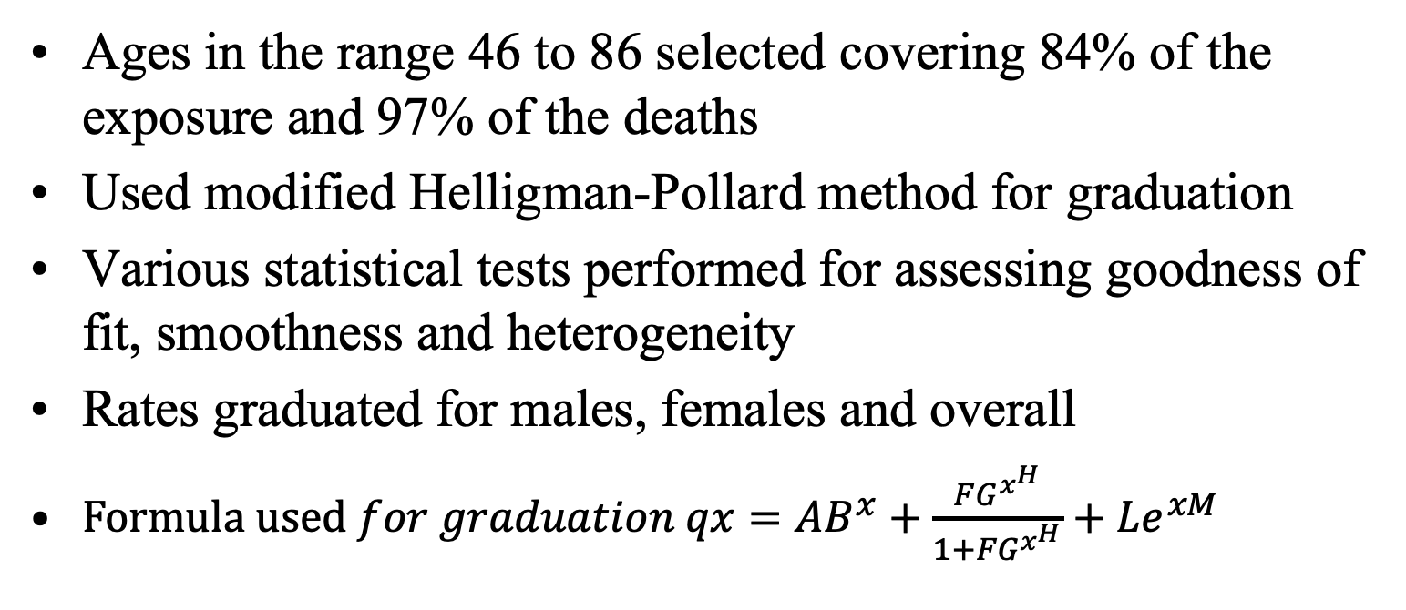
Graduation
Ages in the range 46 to 86 selected covering 84% of the exposure and 97% of the deaths
Used modified Helligman-Pollard method for graduation
Various statistical tests performed for assessing goodness of fit, smoothness and heterogeneity
Rates graduated for males, females and overall
$Formula used for graduation qx={AB}^{x}+\frac{FG^{x^{H}}}{1+{FG}^{x^{H}}}+{Le}^{xM}$
www.actuariesindia.org

Slide 13
Crude and Graduated Rates 1 / 3
www.actuariesindia.org

Slide 14
Crude and Graduated Rates 2 / 3
www.actuariesindia.org

Slide 15
Crude and Graduated Rates 3 / 3
Graduation fits well
Increase in mortality rate is gradual from one age to next, with average increase of 11% for age range 46 to 86
www.actuariesindia.org

Slide 16
Comparisons 1 / 2
Individual Annuitants Mortality 2012-15 Rates are lighter than Group Annuitants 2012-16 from the ages 54 to 86 with average % gap works out to be about 18%.
Group Annuitants 2012-16 Rates are lighter than Group annuitants 1996-98 and IALM 2015-17 across the ages 46 to 86 with average % gap is about 27% and 21% respectively
www.actuariesindia.org

Slide 17
Comparisons 2 / 2
www.actuariesindia.org

Slide 18
Final Tables
Graduated Mortality Rates combined for genders
Graduated Mortality Rates for males
Graduated Mortality Rates for females
www.actuariesindia.org

Slide 19
Current Status
IAI Council adopted the Report in April 2022
Under IRDAI’s consideration for concurrence of table in accordance with Regulations
www.actuariesindia.org

Slide 20

www.actuariesindia.org

