Slide 1


Seminar Name : 20th Seminar on Current Issues in Retirement Benefits
Venue : Orchid Hotel, Mumbai
Date : 26th August’23
Liability Driven Investments for DB Plans
Speakers name : Subbaiah K P
Designation : Sr. Executive Vice President & Functional Head – Funds
Corporate Solutions Group, Kotak Life Insurance Company Limited

Slide 2




Defining Liability Driven Investing (LDI)
What is Liability-Driven Investing (LDI)?
This is an approach that focuses the investment policy and asset allocation decisions on matching the current and future cash flows of the DB Plans. While exact matching is not possible, we need to glide in the same direction
LDI can effectively manage portfolio risk and help minimize the impact of the DB Plan on the organization’s financial health.
LDI shifts the focus away from simply beating benchmarks towards improving and stabilizing the funded status of the plan.
Tailored LDI strategy that focuses on aligning behavior of the total asset portfolio to the behavior of the total DB liabilities such that it fits the organization goals and delivers real, lasting value for the plan.
www.actuariesindia.org

Slide 3
Understanding Importance of Liability Behavior
For Defined Benefit Plans
www.actuariesindia.org

Slide 4
LIABILITY GROWTH & FACTORS IMPACTING VALUATION
www.actuariesindia.org

Slide 5
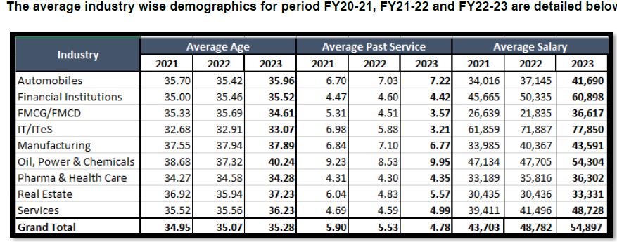
Source: Industry Study on Employee Benefits Actuarial Assumptions & Experience – 2023
A Study by Universal Actuaries & Benefit Consultants
www.actuariesindia.org

Slide 6
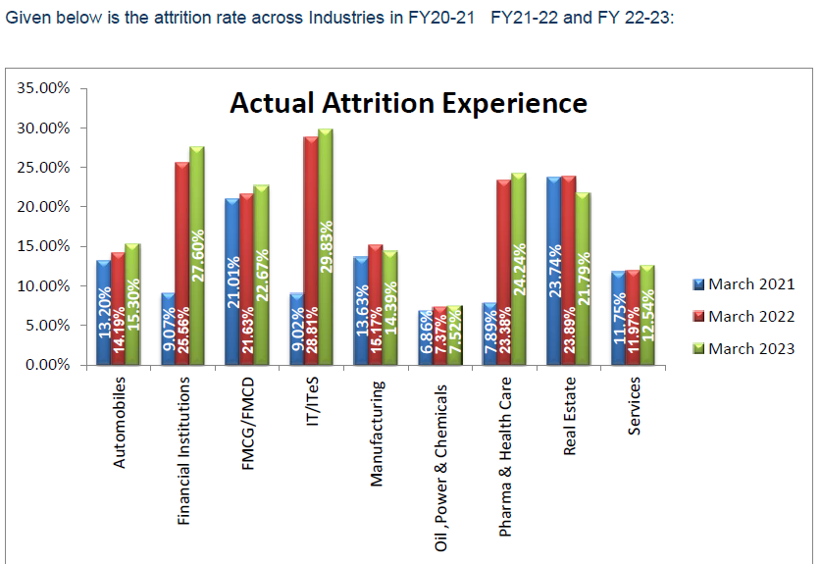
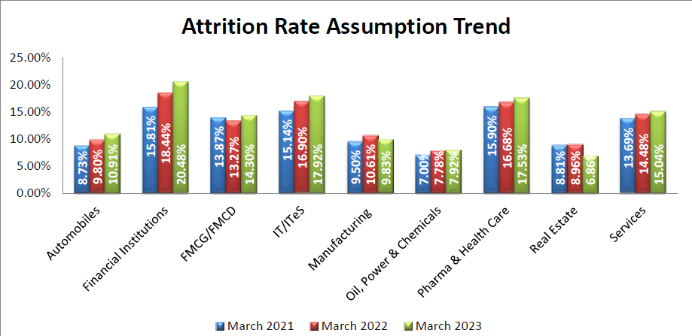
Source: Industry Study on Employee Benefits Actuarial Assumptions & Experience – 2023
A Study by Universal Actuaries & Benefit Consultants
www.actuariesindia.org

Slide 7
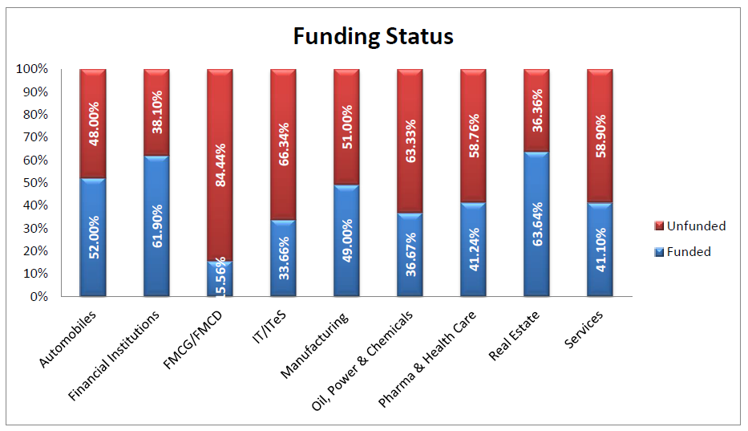
Gratuity is defied as part of salary under u/s 17 (1), hence should not be accrued by provisioning only
Tax benefits
Prudent Corporate Governance
Funding reduces liabilities and improves the valuation on the company
New Wage Code?
Source: Industry Study on Employee Benefits Actuarial Assumptions & Experience – 2023
A Study by Universal Actuaries & Benefit Consultants
www.actuariesindia.org

Slide 8
Understanding Liability Behaviour
Understanding XXX Ltd Liability Behaviour as on (in ₹ )
Description | 31-Mar-21 | 31-Mar-22 | 31-Mar-23 | CAGR
 |  |  |  | (2 years)
No. of Employees | 429 | 442 | 444 | 1.73%
Total Monthly Basic Salary | 10,182,000 | 12,173,000 | 13,735,000 | 16.14%
Avg Monthly Salary | 23,734 | 27,541 | 30,935 | 14.17%
Avg Age (Years) | 37.29 | 37.87 | 38.89 | 2.12%
Avg Past Service (Years) | 8.45 | 8.82 | 9.11 | 3.83%
Adjusted Future Service (Years) | 16.49 | 16.16 | 15.8 | -2.11%
Gratuity Liability | 54,656,861 | 63,750,186 | 70,796,742 | 13.81%
Gratuity Liability per Employee | 127,405 | 144,231 | 159,452 | 11.87%
The Liability is growing at 13+% @ 2 years CAGR, it is doubling approx. every 6-7 years
Liability per employee growing at approx. 12% @ 2 year CAGR. Impact of New Wage Code could be significant
Automotive Industry has lumpy increase in head count, linked to plant expansions or acquisition/mergers
Low attrition has resulted in high past service and significantly high Liability Duration, though aligned to your industry.
Av. Past Service of 9.11 years (P.Y. 8.82 years) means most of the liability is vested
Withdrawal rate: Up to 30 Yrs –3%, 31-44 Yrs –2% & above 45 Yrs –1%, influences DURATION and MATURITY PROFILE
Maturity Profile of Projected Benefit Payments (₹) | 31-Mar-23 | % | 31-Mar-22 | % | YOY %
Year 1 | 3,994,531 | 5.6% | 2,615,737 | 4.1% | 53%
Year 2 | 1,473,848 | 2.1% | 3,729,708 | 5.9% | -60%
Year 3 | 4,441,463 | 6.3% | 4,005,443 | 6.3% | 11%
Year 4 | 2,764,520 | 3.9% | 2,522,539 | 4.0% | 10%
Year 5 | 2,278,731 | 3.2% | 1,937,226 | 3.0% | 18%
Years 6 | 3,042,081 | 4.3% | 3,247,918 | 5.1% | -6%
Balance Years | 52,801,568 | 74.6% | 45,691,615 | 71.7% | 16%
Total Estimated Cash Flows | 70,796,742 | 100.0% | 63,750,186 | 100.0% | 11%
www.actuariesindia.org

Slide 9
Understanding Importance of meeting ALM
For Defined Benefit Plans
www.actuariesindia.org

Slide 10
Understanding Asset Duration
Duration of Debt
Bond duration is a measure of the weighted average of each cash flow that’s due to be received over the life of the bond.
The lower the duration, the sooner the investor is theoretically repaid on an investment.
It’s also a measure of the sensitivity of the bond’s price to changes in interest rates. Higher the duration, higher is the sensitivity to the change in price of bond
Duration of Equity
Equity duration can be considered as a measure of how long an investor must receive dividends in order to be repaid the purchase price of the stock. Since cash flows are weighted by their present value, equity duration—like bond duration—can also be a measure of how sensitive the stock price is to changes in interest rates
There’s no generally accepted formula for equity duration as there is for bond duration, the concept for both is similar, with the caveat that dividend payments aren’t nearly as certain as a bond’s coupon payments are, hence the lack of consensus on how to calculate equity duration
www.actuariesindia.org

Slide 11
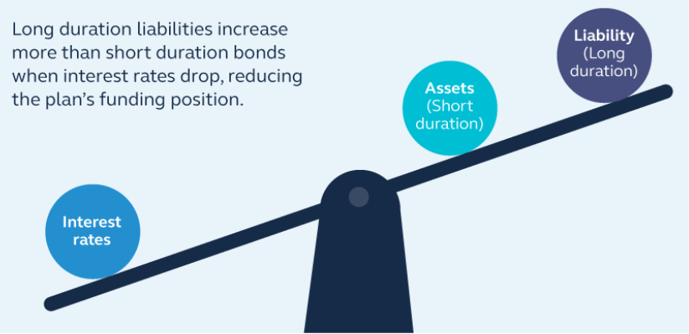
Focus on Impact of Interest Rate
For Asset-Liability Management, clutter must give way to focus on “Interest Rate”
  Short Duration Asset is less sensitive to changes in Interest Rate, increasing fund gap in the long run as liabilities tend to have longer duration
  Meeting Asset – Liability Duration goals will result in growth rate of both asset and liability glide in the same direction.
www.actuariesindia.org

Slide 12
Understanding Liability Behaviour - Sensitivity Analysis
Case Study
Duration ←→ Sensitivity
Description | 31-Mar-23 | 31-Mar-22
Gratuity Liability | 70,796,742 | 63,750,186
Impact of 1% +ve of Discount Rate | (6,720,572) | (6,294,240)
Impact of 1% -ve of Discount Rate | 7,227,664 | 6,786,872
Sensitive to 1% Change (M Duration) | 9.9% | 10.3%
If ALM Goals are met, both asset and liability will glide in the same direction
The pace of growth of both the Liability and Asset, will be determined by their respective durations
FOCUS SHOULD BE ON THE NET FUNDING GAP ONLY.
Change in Discount Rate | 31-Mar-23
 | 1% -ve | 1% +ve
Assuming funded status of Op. DBO | 70,796,742 | 70,796,742
Debt Fund Returns (assumed) | 13.29% | 3.42%
Fund Value + Returns | 80,205,629 | 73,217,991
DBO Adj. for Discount Rate (+/- 1%) | 78,024,406 | 64,076,170
Net Funding Gap on Closing Liability | (2,181,223) | (9,141,821)
Estimated % of Funding Gap on Cl. Liability | -2.8% | -14.3%
(Reference Returns : Kotak Group Bond Fund for FY20 -13.29%, FY22 – 3.42%)
www.actuariesindia.org

Slide 13

ALM – Matching Duration
Liability and Asset (Debt Funds) are influenced by G-Sec Movement
Sensitivity of Liability is significantly more, as they tend to have a longer duration than the duration of the asset
www.actuariesindia.org

Slide 14
Understanding IND AS19 – Transfer to OCI
DBO | March'23 |  | Fair Value of Assets | March'23
PV of DBO at start of period | 100 |  | FV at the start of period | 95
Current Service Cost | 20 |  | Contribution by employer | 40
Past Service Cost | 10 |  | Benefits Paid | (25)
Interest Cost | 8 |  | Interest Income | 6
Benefits Paid | (25) |  | Returns over interest income | 2
Actuarial Loss/(Gains) | 8 |  | FV at the end of period | 118
PV of DBO at end of period | 121
 |  |  | Re-Measurements | March'23
Employer Expenses | March'23 |  | Actuarial Loss/(Gains) on DBO | 8
Current Service Cost | 20 |  | Returns over interest income | (2)
Past Service Cost | 10 |  | Total Remeasurement (OCI) | 6
Interest Cost on net DBO | 2
Employer Expenses (P&L) | 32 |  | Movement | March'23
 |  |  | Opening Net Liability (100-95) | 5
 |  |  | Add: Employer Expenses | 32
 |  |  | Add: Transfer to OCI | 6
 |  |  | Less: Employer Contribution | (40)
 |  |  | Closing Net Liabilty | 3
Under IND AS19
Actuarial Gains and losses are transferred to OCI, does not impact P&L
Short Term Volatility is smoothened in IND AS19
AS15 Movement | March'23
Opening Net Liability (100-95) | 5
Add: Employer Expenses | 38
Less: Employer Contribution | (40)
Closing Net Liability | 3
www.actuariesindia.org

Slide 15

Achieving ALM Goals for Defined Benefit Liability Plans
www.actuariesindia.org

Slide 16
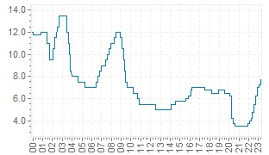
RISK REWARD WITH DURATION – Historical RBI Action
Time Period |  | Repo Rate |  | Hike Cycle in No of Months | Cumulative Repo Hike | Remarks
Start | End | Start | End
Aug-03 | Jul-08 | 4.5 | 9.0 | 59 | 450
Apr-09 | Oct-11 | 4.8 | 8.5 | 30 | 375
Jun-13 | Jan-14 | 7.3 | 8.0 | 7 | 75 | *Effective hike was 175bps as Marginal Standing Facility (MSF) was operational rate
Apr-18 | Aug-18 | 6.0 | 6.5 | 4 | 50
Dec-18 | May-20 | 6.5 | 4.0 | 17 | (250)
May-22 | On going | 4.0 | 6.50 | 12 | 250 | May’– 40 bps, June – 50 bps, Aug – 50 bps, Sept -50 bps, Dec-35 bps, Jan – 25 bps
RBI action captures the impact on GSEC
Clear trend is the new GSEC Peaks are significantly lower than the previous decades
Historical Repo Rate Timeline Since 2000
Historical 10 Year G Sec Timeline for last 25 years
www.actuariesindia.org

Slide 17
Rates – G Sec Trends vs GDP
As India’s Economy becomes Stronger – More buyers could lead to lower rates
Year | Financial Year | 10Y G SEC Rate | 1Y Change | 3Y Change | 5Y Change | Indian GDP $ Billion (Calendar Year)
 |  |  | G SEC | G SEC | G SEC
0 | 2006-07 | 7.98% |  |  |  | 1216
1 | 2007-08 | 7.96% | -0.3% |  |  | 1199 | -1%
2 | 2008-09 | 7.01% | -11.9% |  |  | 1342 | 12%
3 | 2009-10 | 7.83% | 11.7% | -0.6% |  | 1676 | 25%
4 | 2010-11 | 7.99% | 2.0% | 0.1% |  | 1823 | 9%
5 | 2011-12 | 8.54% | 6.9% | 6.8% | 1.4% | 1828 | 0%
6 | 2012-13 | 7.96% | -6.8% | 0.6% | 0.0% | 1857 | 2%
7 | 2013-14 | 8.80% | 10.6% | 3.3% | 4.7% | 2039 | 10%
8 | 2014-15 | 7.74% | -12.0% | -3.2% | -0.2% | 2104 | 3%
9 | 2015-16 | 7.47% | -3.5% | -2.1% | -1.3% | 2295 | 9%
10 | 2016-17 | 6.68% | -10.6% | -8.8% | -4.8% | 2651 | 16%
11 | 2017-18 | 7.40% | 10.8% | -1.5% | -1.4% | 2701 | 2%
12 | 2018-19 | 7.35% | -0.7% | -0.5% | -3.5% | 2871 | 6%
13 | 2019-20 | 6.14% | -16.5% | -2.8% | -4.5% | 2623 | -9%
14 | 2020-21 | 6.17% | 0.5% | -5.9% | -3.8% | 3173 | 21%
15 | 2021-22 | 6.84% | 10.9% | -2.4% | 0.5% | 3737 | 18%
16 | 2022-23 | 7.32% | 7.0% | 6.0% | -0.2%
As India moves to a 5 Trillion economy, we understand that the
GSEC is expect to have downward bias.
Clear link to strength of the economy (read GDP) and G Sec rates. Stronger the economy, lower the rates, lower the spikes
Year FY11,12,13 – G Sec 7.439% to 9.044%, as the Indian Economy stagnated
Year FY15,16,17 – G Sec 6.243% to 7.861% as the Indian Economy grew
FY23 Interest spikes 7.6% not sustaining
Long term rates clearly gliding to lower levels
India’s inclusion in the Global Bond Index could hasten the fall of G-Sec
www.actuariesindia.org

Slide 18
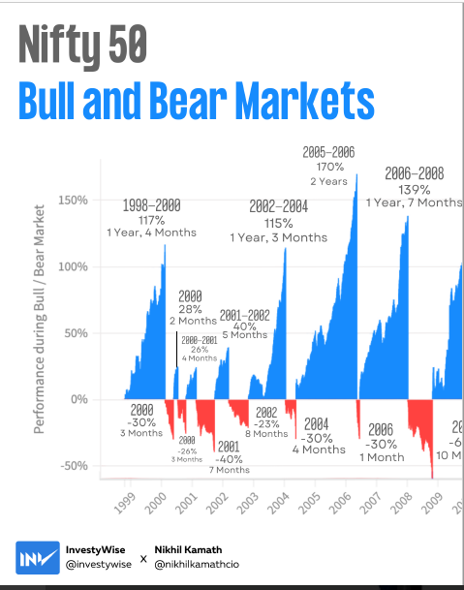
Equity – Bulls & Bears Markets
www.actuariesindia.org

Slide 19
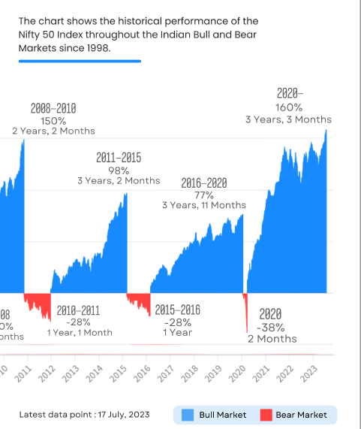
Equity – Bulls & Bears Markets
www.actuariesindia.org

Slide 20
Institution Vs Underlying Assets
Lessons from Unit Trust Of India – US-64 :
  Sustainable Returns can only come from the underlying assets
  Importance of Risk Management
Sovereign Guarantees remains on paper.
  The FRMB Act, (Fiscal Responsibility and Budgetary Management Act) caps sovereign guarantees at 0.5% of GDP in any Financial Year from 2004.
  Overall cap of 9% of GDP for all guarantees
  Lenders have to take 10-30% loss
LIC post IPO
  Funds are now bifurcated. Ability to cross subsidize to low margin products, could significantly reduce
  Expect a change to a more profitable product portfolio
  Regulatory change could force more efficiency in cost rationalization
  Pension Fund Write-Off FY23 4548.85 Crs (P.Y. 2022.61 Crs) Source: L33 – Public Disclosures
To summarize, Customers must give more weight to Underlying Assets than the Institution managing the same, as minority stakeholders are always bear the brunt of any fallout (in the absence of solvency risk due to regulatory framework)
LIC Traditional Portfolio March’22 | AUM | % Total
 | (Rs. Crs)
Central Government Securities | 290,068 | 34%
Other Approved Securities | 3,898 | 1%
State Government Securities | 385,163 | 45%
TREPS, MF, Bank Balance | 11,963 | 1%
Loan Book | - | 0%
NCD/Bonds | 83,743 | 10%
Equity | 76,392 | 9%
Fixed Deposit | 1,000 | 0%
Grand Total | 852,227 | 100%
www.actuariesindia.org

Slide 21
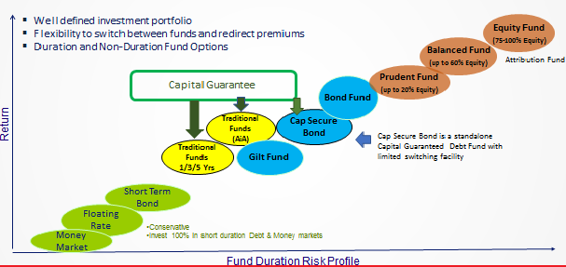
Investment Duration options with Kotak Life
www.actuariesindia.org

Slide 22
Understanding Investment Duration options
Non Duration - Traditional Funds (LIC Type) | Duration - Linked Funds
1. Fund with a ONE year return view | 1. Multiple Durations possible
2. Capital & Return Guarantee | 2. Capital Guarantee is a fund option
3. Single Fund | 3. Multiple Fund Options, risk adjusted rewards
4. Liability Driven ALM Goals not possible | 4. Glide path to ALM Goals
5. No requirement to disclose portfolio | 5. Mandatory to disclose portfolio
6. Risk-Reward to Insurer | 6. Risk-Reward to Customer
7. Returns based on Insurer Management | 7. Returns a reflection of underlying assets
Illustration that even a small change over a long duration, has a significant impact
Small Change | Impact
(1.00)^365 | 1
(1.01)^365 | 37.8
www.actuariesindia.org

Slide 23
Returns – Non Duration Fund Vs Duration Fund
Year | LIC V3 (50 -100 Crs) | Kotak Life Insurance Duration Funds (After add back of Residual Addition or Loyalty Additions)
FY | Traditional Annual Rate | Cap Sec Fund (UL) | Alpha over LIC | Bond Fund (UL) | Alpha over LIC | Balanced Fund (UL) | Alpha over LIC | Prudent Fund (UL) | Alpha over LIC
FY23 | 7.11% | 3.80% | -3.31% | 4.15% | -2.96% | 1.75% | -5.36% | 3.85% | -3.26%
FY22 | 7.01% | 3.60% | -3.41% | 3.95% | -3.06% | 14.75% | 7.75% | 6.62% | -0.39%
FY21 | 7.06% | 8.20% | 1.14% | 8.45% | 1.39% | 40.45% | 33.39% | 16.62% | 9.56%
FY20 | 7.62% | 13.30% | 5.68% | 14.40% | 6.78% | -8.25% | -15.87% | 6.32% | -1.30%
FY19 | 7.62% | 8.80% | 1.18% | 9.40% | 1.78% | 10.45% | 2.83% | 11.20% | 3.58%
Av. 5 Yr | 7.28% | 7.54% | 0.26% | 8.07% | 0.79% | 11.83% | 4.55% | 8.92% | 1.64%
Under IND AS19, short term volatility of investments is smoothened through OCI, encourages duration matching. Volatility does not impact P&L under IND AS19
There are significant gains in gliding towards duration matching goals
G-Sec Rates impacts both Discount Rates and Yields on Bonds, hence durations matching is important
www.actuariesindia.org

Slide 24
Glide towards Duration Funds
Year | NAV |  | New LIC Rate 100 Crs Slab | Closing Fund Balanced (INR Lakhs)
 | Bond | Balanced |  | LIC Trad | Bond | Balanced
14-Mar | 22.42 | 38.54 | 8.75% | 1000 | 1000 | 1000
15-Mar | 26.51 | 50.04 | 8.90% | 1088 | 1182 | 1298
16-Mar | 27.40 | 50.34 | 8.35% | 1184 | 1222 | 1306
17-Mar | 31.82 | 59.22 | 7.85% | 1283 | 1419 | 1537
18-Mar | 33.37 | 64.09 | 7.70% | 1384 | 1488 | 1663
19-Mar | 36.15 | 70.39 | 7.58% | 1490 | 1612 | 1826
20-Mar | 40.77 | 64.16 | 7.62% | 1603 | 1818 | 1665
21-Mar | 44.19 | 89.68 | 7.06% | 1726 | 1971 | 2327
22-Mar | 45.61 | 102.29 | 7.01% | 1847 | 2034 | 2654
23-Mar | 47.36 | 103.46 | 7.11% | 1977 | 2112 | 2684
Alpha over LIC New Plan |  |  |  |  | 136 | 708
Alpha % over LIC New Plan |  |  |  |  | 6.86% | 33.50%
Duration Funds will out perform the non-duration funds. Returns reflection of Asset Allocation strategies
By achieving ALM Goals, Liability and Asset will glide in the same direction
Asset or Liability Growth rates, influenced by respective duration
Duration Funds ←→Net Funding Gap Focus
www.actuariesindia.org

Slide 25
Glide towards Duration Funds – Kotak Bond Fund
Kotak Bond Fund NAV Rolling Returns
No | GSEC Rate | Year | Bond NAV | 1yr | 3yr | 5yr | 7yr | 10yr
0 | 8.19 | 7-Jun | 11.78
1 | 8.71 | 8-Jun | 12.77 | 8.4%
2 | 7.01 | 9-Jun | 15.38 | 20.4%
3 | 7.56 | 10-Jun | 16.95 | 10.2% | 12.9%
4 | 8.33 | 11-Jun | 18.02 | 6.3% | 12.2%
5 | 8.39 | 12-Jun | 20.20 | 12.1% | 9.5% | 11.4%
6 | 7.44 | 13-Jun | 22.93 | 13.5% | 10.6% | 12.4%
7 | 8.74 | 14-Jun | 23.71 | 3.4% | 9.6% | 9.0% | 10.5%
8 | 7.86 | 15-Jun | 26.51 | 11.8% | 9.5% | 9.4% | 11.0%
9 | 7.45 | 16-Jun | 29.37 | 10.8% | 8.6% | 10.3% | 9.7%
10 | 6.51 | 17-Jun | 32.83 | 11.8% | 11.5% | 10.2% | 9.9% | 10.8%
11 | 7.90 | 18-Jun | 32.94 | 0.3% | 7.5% | 7.5% | 9.0% | 9.9%
12 | 6.88 | 19-Jun | 37.58 | 14.1% | 8.6% | 9.6% | 9.3% | 9.3%
13 | 5.89 | 20-Jun | 42.97 | 14.4% | 9.4% | 10.1% | 9.4% | 9.7%
14 | 6.05 | 21-Jun | 44.63 | 3.9% | 10.7% | 8.7% | 9.5% | 9.5%
15 | 7.45 | 22-Jun | 45.10 | 1.0% | 6.3% | 6.6% | 7.9% | 8.4%
16 | 7.11 | 23-Jun | 48.40 | 7.3% | 4.0% | 8.0% | 7.4% | 7.8%
Probability of Loss |  |  |  | 0.0% | 0.0% | 0.0% | 0.0% | 0.0%
Average Return |  |  |  | 9.36% | 9.35% | 9.43% | 9.36% | 9.34%
Standard Deviation |  |  |  | 5.25% | 2.26% | 1.56% | 1.03% | 0.91%
INR 2293 invested in June’13 grows to INR 4840 in June’23 giving a 10 year returns of 7.80%, for this cohort of investment (Std. FMC before RA/LA)
Key is to invest across interest rate cycles as asset returns are dynamic for each cohort
Average Returns to be the focus
Probability of capital loss on a 12 month horizon is very remote, in the absence of credit risks
IND AS19 allows by smoothening through OCI and no impact to P&L . With ALM, the glide path of Asset & Liability will be in the same direction
www.actuariesindia.org

Slide 26
Glide towards Duration Funds – Kotak Balanced Fund
Balance Fund NAV Rolling Returns ( Up to 60% Equity)
No | GSEC Rate | Sensex | Date | Balanced Fund NAV | 1yr | 3yr | 5yr | 7yr | 10yr
0 | 8.16 | 10,609 | 6-Jun | 18.62
1 | 8.19 | 14,651 | 7-Jun | 24.00 | 28.9%
2 | 8.71 | 13,462 | 8-Jun | 24.08 | 0.3%
3 | 7.01 | 14,494 | 9-Jun | 25.49 | 5.9% | 11.0%
4 | 7.56 | 17,701 | 10-Jun | 29.86 | 17.1% | 7.6%
5 | 8.33 | 18,846 | 11-Jun | 31.74 | 6.3% | 9.6%
6 | 8.39 | 17,430 | 12-Jun | 31.81 | 0.2% | 7.7% | 5.8%
7 | 7.44 | 19,396 | 13-Jun | 35.62 | 12.0% | 6.1% | 8.1%
8 | 8.74 | 25,414 | 14-Jun | 43.00 | 20.7% | 10.7% | 11.0% | 8.7%
9 | 7.86 | 27,781 | 15-Jun | 50.10 | 16.5% | 16.3% | 10.9% | 11.0%
10 | 7.45 | 27,000 | 16-Jun | 53.66 | 7.1% | 14.6% | 11.1% | 11.2%
11 | 6.51 | 30,922 | 17-Jun | 61.34 | 14.3% | 12.6% | 14.0% | 10.8% | 9.8%
12 | 7.90 | 35,423 | 18-Jun | 64.99 | 6.0% | 9.1% | 12.8% | 10.8% | 10.4%
13 | 6.88 | 39,395 | 19-Jun | 71.81 | 10.5% | 10.2% | 10.8% | 12.3% | 10.9%
14 | 5.89 | 34,916 | 20-Jun | 72.03 | 0.3% | 5.5% | 7.5% | 10.6% | 9.2%
15 | 6.05 | 52,483 | 21-Jun | 95.02 | 31.9% | 13.5% | 12.1% | 12.0% | 11.6%
16 | 7.45 | 53,019 | 22-Jun | 95.43 | 0.4% | 9.9% | 9.2% | 9.6% | 11.6%
17 | 7.11 | 64,719 | 23-Jun | 112.50 | 17.9% | 16.0% | 11.6% | 11.2% | 12.2%
Probability of Loss |  |  |  |  | 0% | 0% | 0% | 0% | 0%
Average Return |  |  |  |  | 10.5% | 10.7% | 10.4% | 10.8% | 10.8%
Standard Deviation |  |  |  |  | 8.7% | 3.3% | 2.2% | 1.0% | 1.0%
INR 3562 invested in June’13 grows to INR 11250 in June’23 giving a 10 year returns of 12.2%, for this cohort of investment (Std. FMC before RA/LA)
Key is to invest across cycles as funds management unfolds and short term volatility smoothens.
Average Returns to be the focus
Probability of capital loss on a longer horizon is very low, in the absence of credit risks
IND AS19 allows by smoothening through OCI and no impact to P&L . With ALM, the glide path of Asset & Liability will be in the same direction
www.actuariesindia.org

Slide 27
Equity Attribution – 25 Years Sensex Rolling Returns, June’23
SENSEX Rolling Returns
No | Date | Sensex | 1yr | 3yr | 5yr | 7yr | 10yr | 15yr
0 | Jun-98 | 3,251
1 | Jun-99 | 4,141 | 27.4%
2 | Jun-00 | 4,749 | 14.7%
3 | 1-Jun | 3,457 | -27.2% | 2.1%
4 | 2-Jun | 3,245 | -6.1% | -7.8%
5 | 3-Jun | 3,607 | 11.2% | -8.8% | 2.1%
6 | 4-Jun | 4,795 | 32.9% | 11.5% | 3.0%
7 | 5-Jun | 7,194 | 50.0% | 30.4% | 8.7% | 12.0%
8 | 6-Jun | 10,609 | 47.5% | 43.3% | 25.1% | 14.4%
9 | 7-Jun | 14,651 | 38.1% | 45.1% | 35.2% | 17.5%
10 | 8-Jun | 13,462 | -8.1% | 23.2% | 30.1% | 21.4% | 15.3%
11 | 9-Jun | 14,494 | 7.7% | 11.0% | 24.8% | 23.8% | 13.3%
12 | 10-Jun | 17,701 | 22.1% | 6.5% | 19.7% | 25.5% | 14.1%
13 | 11-Jun | 18,846 | 6.5% | 11.9% | 12.2% | 21.6% | 18.5%
14 | 12-Jun | 17,430 | -7.5% | 6.3% | 3.5% | 13.5% | 18.3%
15 | 13-Jun | 19,396 | 11.3% | 3.1% | 7.6% | 9.0% | 18.3% | 12.6%
16 | 14-Jun | 25,414 | 31.0% | 10.5% | 11.9% | 8.2% | 18.1% | 12.9%
17 | 15-Jun | 27,781 | 9.3% | 16.8% | 9.4% | 10.9% | 14.5% | 12.5%
18 | 16-Jun | 27,000 | -2.8% | 11.7% | 7.5% | 9.3% | 9.8% | 14.7%
19 | 17-Jun | 30,922 | 14.5% | 6.8% | 12.1% | 8.3% | 7.8% | 16.2%
20 | 18-Jun | 35,423 | 14.6% | 8.4% | 12.8% | 9.4% | 10.2% | 16.5%
21 | 19-Jun | 39,395 | 11.2% | 13.4% | 9.2% | 12.4% | 10.5% | 15.1%
22 | 20-Jun | 34,916 | -11.4% | 4.1% | 4.7% | 8.8% | 7.0% | 11.1%
23 | 21-Jun | 52,483 | 50.3% | 14.0% | 14.2% | 10.9% | 10.8% | 11.2%
24 | 22-Jun | 53,019 | 1.0% | 10.4% | 11.4% | 9.7% | 11.8% | 9.0%
25 | 23-Jun | 64,719 | 22.1% | 22.8% | 12.8% | 13.3% | 12.8% | 11.0%
Probability of Loss |  |  | 24.0% | 8.7% | 0.0% | 0.0% | 0.0% | 0.0%
Average Returns |  |  | 14.4% | 12.9% | 13.2% | 13.7% | 13.2% | 13.0%
Standard Deviation |  |  | 20% | 13% | 9% | 5% | 4% | 2%
Long duration funds have short term volatility which gets smoothened with time
Probability of loss significantly reduce with time
Accounting Standards IND AS19 allows for smoothening short term volatility
Long term gains by of superior returns justifies duration risk
Duration Risk Adjusted Average Return is in the band around 13.0%, significantly more that Fixed Income
www.actuariesindia.org

Slide 28
Equity Attribution – 100% Equity Fund
SENSEX 10Y PERFORMANCE
From | TO | 10Y CAGR | 5Y Av.
June'98 | June'08 | 15.3%
June'99 | June'09 | 13.3%
June'00 | June'10 | 14.1%
June'01 | June'11 | 18.5%
June'02 | June'12 | 18.3% | 15.9%
June'03 | June'13 | 18.3% | 16.5%
June'04 | June'14 | 18.1% | 17.5%
June'05 | June'15 | 14.5% | 17.5%
June'06 | June'16 | 9.8% | 15.8%
June'07 | June'17 | 7.8% | 13.7%
June'08 | June'18 | 10.2% | 12.1%
June'09 | June'19 | 10.5% | 10.6%
June'10 | June'20 | 7.0% | 9.1%
June'11 | June'21 | 10.8% | 9.3%
June'12 | June'22 | 11.8% | 10.1%
June'13 | June'23 | 12.8% | 10.6%
Average |  | 13.2% | 13.2%
Standard Deviation |  | 3.7% | 3.2%
Where Wt. Liability Duration is more than 7-8 Years, equity is recommended
Meet ALM Goals
Duration Risk Adjusted Average 10Y CAGR is around 13+%, significantly more that any fixed income product
Risk Mitigation for equity investments
  100% Equity Attribution Fund
  Capping of Equity Exposure
  Sustain investment pattern over cycles
www.actuariesindia.org

Slide 29
Summary & Recommendation
Defined Benefit Liability Funding – Liability Behaviour to drive the Asset Allocation Strategies
Maximize benefits of IND AS19 - Short volatility smoothened to OCI, no impact on P&L
  Achieve ALM Goals matching duration means Asset and Liability growth will glide in the same direction, bring the focus to Net Funding
Long duration Assets
  Key is to invest across interest rate cycles, as dynamic asset duration management unfolds.
  Probability of capital loss on a longer horizon is diminishes significantly
Risk Mitigation Strategies
  Mix of Non-duration (Traditional) and Duration (Linked Funds with or with Capital Guarantee)
  Sticking to a well defined funding plan across cycles, not timing the market (SIP)
  Capping Equity Exposure
  Trust the Insurers Duration Management once asset allocation strategies are defined
Recommendations
  Based on the liability duration and lumpiness of settlement, multiple asset classes should be considered
  ALM Goals should be driven by Liability Duration and expected Cash Outflows for Settlements
  Get the benefits for a higher planned funded status
  Consistent investments strategies across cycles is important
www.actuariesindia.org

Slide 30
Question for our Actuaries ?????
Process for Setting Up a Gratuity Fund
Board of Directors
Setting up a Gratuity Fund and selecting a service provider to manage the funds.
Trustees
Finalize the Gratuity scheme benefits
Kotak Life Insurance
Provide inputs on the benefits of creation of Gratuity Trust
Support in getting PAN, Bank account
Appointment of a minimum of 2 Trustees who are employees of the Indian entity and Indian residents
Authorizing the Trustees to take all necessary actions to set up the Trust
Opening a Trust Bank Account
Drafting of Trust Deed & Rules
Application to Commissioner of Income Tax (CIT) for approval of Trust
Apply for Permanent Account Number
Open a Trust bank account
Support in Drafting Trust Deed and Rules
Support in application to CIT and getting necessary approvals
Manage fund to ensure asset-liability gap is reduced
If Irrevocable Trust Deed is not created nor filed with CIT for approval, the fund is of the company.
  Is the liability rightly recognized?
  Is the employer expense rightly stated (Eg. interest cost)?
How do you protect yourselves?
  Copy of Trust Application with CIT/CIT Approval
  An approval for a fund which is already set up is in the nature of post facto approval and it relates back to the date on which it is set up in accordance with the scheme of the law – Prakash Software Solution (P.) Ltd. v. Income-tax Officer [2018] 89 taxmann.com 130 (Ahmedabad – Trib.)
www.actuariesindia.org

Slide 31
Important Case Laws on Gratuity Trusts/Fund
Commissioner has the power to accord approval to Gratuity Fund with retrospective effect from the date from which the Fund satisfied the requirements of rule 3 of Part C of the Fourth Schedule. – Clarification 3 in Circular No. 14 [F. No. 19/4/69-IT(A-II)], dated 23-4-1969.
ITO cannot question the validity of approval granted to a Gratuity Fund by the Commissioner. If there is an anomaly in the approval granted, only the Commissioner has the power to take corrective steps. All that the ITO can do is examine the conditions precedent to claiming deduction u/s 36(1)(v) – [1993] 71 Taxman 226 (Calcutta)
Where an assessee company has made payment directly to Life Insurance Corporation of Indian towards premium for Group Gratuity Scheme held in the name of Approved Gratuity Fund instead of first contributing to Approved Gratuity Fund and Approved Gratuity Fund making the payment of premium, deduction u/s 36(1)(v) will be allowable – CIT vs. Textool Co. Ltd. [2013] 35 taxmann.com 639 (Supreme Court)
Where an assessee had filed application to competent authority for approval of a Gratuity Scheme and had duly complied with conditions laid down for approval, Assessing Officer cannot disallow assessee’s claim for deduction under section 36(1)(v) merely because the application for approval was pending before the Commissioner. The Commissioner should have either rejected or approved the Gratuity Scheme – CIT vs Jaipur Thar Gramin Bank [2017] 81 taxmann.com 126 (Rajasthan)
Payment on a date after the creation of Trust but prior to date of approval of Gratuity Fund will be allowed as deduction u/s 36(1)(v). An approval for a fund which is already set up is in the nature of post facto approval and it relates back to the date on which it is set up in accordance with the scheme of the law – Prakash Software Solution (P.) Ltd. v. Income-tax Officer [2018] 89 taxmann.com 130 (Ahmedabad – Trib.)
www.actuariesindia.org

Slide 32

Open Session
www.actuariesindia.org

Slide 33
Thank You.
Subbaiah K P
Senior Executive Vice President
Kotak Life Insurance Company Limited
Email : Subbaiah.kp@kotak.com
Mobile : +919886747574
www.actuariesindia.org

