Slide 1
Organizer
19th Global
Conference of Actuaries
30th – 31st January, 2018 | Mumbai, India
Mr. Zainal Abidin Mohd Kassim, FIA
Senior Partner

Slide 2
19th Global
Conference of Actuaries
30th – 31st January, 2018 | Mumbai, India
Addressing the shortcomings of the traditional insurance model:
Lessons learnt from Takaful and Discretionary Mutuals
31st January, 2018 Session C15 14:50 – 15.35
Summary of topic: The recent rush to internet based insurance models have not been very successful. It would seem that the existing business models are likely to be predominant for many more years, helped by ever increasing regulatory requirements that prevents the entry of real disruptors. This presentation reviews the success and failures of two alternative insurance models, the Takaful model and the Discretionary Mutual Model, the former looking at experience in Malaysia and the latter in the UK and Australia and asks the question, is it time instead to tweak the existing insurance models for certain lines of business?

Slide 3
19th Global
Conference of Actuaries
30th – 31st January, 2018 | Mumbai, India
Insurance
Modern insurance industry evolved from a Mutual beginning to a profit driven business. Making a profit from the ‘fear of others’. Afraid of flying? Flight insurance. Afraid of old age? Long-term care insurance. Afraid of robbery? Home insurance.
Information asymmetry means that the insured cannot check on the reasonableness of the premium offered and has to instead depend on the “insurance marketplace” to check whether the “price” is fair.
Is the insurance market place efficient and transparent enough?
Public does not do much shopping around so distribution is key to the success of an insurance product.
Life insurance can be part deposit taking part risk taking. While life insurance is unique to the insurance industry, deposit taking is not. Without tax support can the deposit taking function be competitive?

Slide 4
19th Global
Conference of Actuaries
30th – 31st January, 2018 | Mumbai, India
Challenges in Insurance
Insurance fraud can be prevalent as the insured seeks to profit at the insurers (and indirectly other policyholder) expenses.
Little incentives for insurers to rein in claims cost as premiums can be adjusted in line with claims inflation and profit is directly correlated to ‘top line’ when rates are profitable.
The overly dependence on third party distributors, i.e. agents and banks, can make the insurer hostage to the demands of the distributor e.g. higher commissions and less underwriting.
Regulatory structures are now more principles based requiring expensive investments in people and systems with more penal penalties applied on non-compliance

Slide 5
Insurance
19th Global
Conference of Actuaries
30th – 31st January, 2018 | Mumbai, India
Ripe for disruption?
Unlike Uber, Airbnb and low cost air travel, the utility for insurance is contingent in nature. You hope you would not need to claim which is different for Uber, Airbnb and low cost air travel where the utility is 100%.
As underwriting becomes more efficient are we losing the social value of insurance, the healthy to subsidize the sick, the better off to subsidize the poor.
The current insurance model has not been proven successful when applied on a micro basis unless the premiums are heavily subsidized.
Buying insurance is like going to see a dentist you try to postpone it as long as possible! Insurance is still sold rather than bought.

Slide 6
Insurance
19th Global
Conference of Actuaries
30th – 31st January, 2018 | Mumbai, India
Ripe for disruption?
Insurance is an expensive and complicated business which is highly regulated making a huge barrier to entry for potential disruptors
Misselling (normally manifested by very low loss ratios) can happen easily as products can be bundled and the insured non the wiser as he has minimal interaction with the insured.
Likely fintech will go towards reducing costs of operating a traditional insurance business model rather than give rise to real disruptors that we see in other industries. Any cost efficiency is unlikely to make the premium much cheaper given that for most risks distribution costs and claims make up the biggest component of premium.

Slide 7
Alternatives to the Traditional Insurance Model and lessons learnt
19th Global
Conference of Actuaries
30th – 31st January, 2018 | Mumbai, India
Takaful
A hybrid between a Mutual and a proprietary insurer.
Discretionary Mutual
Risk sharing among like minded members

Slide 8
Takaful
19th Global
Conference of Actuaries
30th – 31st January, 2018 | Mumbai, India
Introduced in Malaysia in 1986. It is sharia compliant insurance. A hybrid with a Mutual risk fund bolted to a shareholders fund. The latter is responsible for providing working and solvency capital.
The risk fund provides for an experience refund if a surplus arises at the end if the financial year.
Regulatory Capital for takaful and that for insurance is equivalent.
Distribution of takaful products very much traditional, agents, brokers and bancassurance.
Takaful Manager (Operator)
Profit Motive
Hybrid
Policyholders (Participants) Funds
Cooperative/ Mutual non-profit
oriented

Slide 9
Key Points on where Takaful differs from insurance
19th Global
Conference of Actuaries
30th – 31st January, 2018 | Mumbai, India
The takaful operator charges a fee (the wakala fee) to manage the participants pool and the premium is split into two, the wakala fee goes to the Operator’s Fund and the remainder to the Participants Fund. The split in premium makes the amount of the premium allocated to the operator’s costs and profit transparent.
The premium to the Participants Fund is termed a “donation”, effectively the participant is donating his premium to assist those who have need to draw from the Fund. The classification of the risk premium as a donation appeals to the cooperative spirit of the participant.
Any surplus in the Participant Fund is repaid to the participant as an experience refund. This feature especially appeals to non Muslims who may not subscribe to the sharia compliant nature of the contract.

Slide 10
Malaysia’s experience with Takaful
19th Global
Conference of Actuaries
30th – 31st January, 2018 | Mumbai, India
Takaful products and pricing do not differ significantly to that available in insurance as:
Risk Based Capital solvency requirement for takaful and insurance are similar
Takaful is still “sold” rather than “bought” and there is significant overlap in distribution channels for takaful and insurance. Similar product features and pricing eases the distribution process. Takaful offered for those consumers that request for sharia compliant product.
Major selling point for takaful (other than sharia compliant) is that it offers an experience refund if the Participants’ Fund has a surplus.
Major weakness of takaful is the conflict between shareholders interest (who runs the company) and policyholders interest. This conflict can be “hidden” unlike insurance where the conflict is more apparent.

Slide 11
How is Takaful faring in Malaysia?
19th Global
Conference of Actuaries
30th – 31st January, 2018 | Mumbai, India
Gross contributions
Total gross contribution* for Takaful is estimated at RM10.2 billion in 2016, an increase of 10% from RM9.3 billion in 2015.
The Compound Annual Growth Rate (CAGR) between 2010 and 2016 is 10% for both General Takaful and Family Takaful.
 | General Business | Family Business | Total Takaful Business
2010 – 2016 CAGR | 10% | 10% | 10%
* Total gross contribution from Family Takaful includes new business and inforce contributions.
Source: Actuarial Partners’ analysis of ISM Statistical Bulletin and ISM Statistical Yearbook

Slide 12
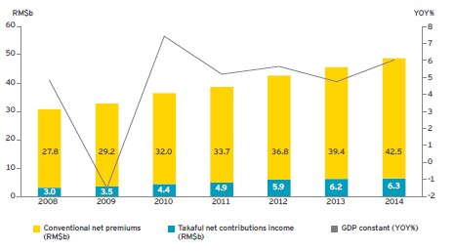
How is Takaful faring in Malaysia?
19th Global
Conference of Actuaries
30th – 31st January, 2018 | Mumbai, India
Malaysia’s insurance takaful and GDP growth
Source:
Economic Outlook Database April 2015, International Monetary Fund;
Financial Stability and Payment System Report 2013 & 2014, Bank Negara Malaysia;
Monthly Statistical Bulletin, May 2015, Bank Negara Malaysia;
EY analysis.

Slide 13
Given the Mutual nature of the Takaful “insurance” pool, is Takaful claims experience better than insurance?
19th Global
Conference of Actuaries
30th – 31st January, 2018 | Mumbai, India
Third Party Personal Injury
1.40
Market
Salam
3.92
Claimants per incidents
1.3
Source: Takaful in a Sceptical Market ITS 2009 Bradley Brandon – Cross
CEO
Salaam Halal Insurance
1.9
Market
Salam

Slide 14
Lessons learnt from Takaful
19th Global
Conference of Actuaries
30th – 31st January, 2018 | Mumbai, India
Malaysia’s population is 60% Muslims yet there was no rush to buy takaful products. Muslims still constitute the majority of the uninsured population in the country. This can be partly explained as they are more non urban in nature where distribution is weak. They also mainly consist of the lower income group. Takaful has really not addressed the issue of distribution and affordability.
Takaful operators, like insurers, are still very much profit driven. Given very similar regulatory capital requirement and the shareholders need for equivalent ROE takaful there is little innovation in the industry.
Takaful companies are start ups. Start ups incur heavy costs in systems and people and would tend to incur losses until they achieve critical volume of business.

Slide 15
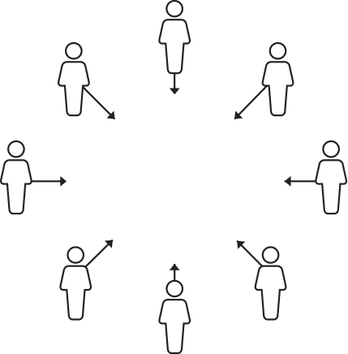
What is a Discretionary Mutual?
19th Global
Conference of Actuaries
30th – 31st January, 2018 | Mumbai, India
A discretionary Mutual is owned by its members
The mutual retains the primary layer of risk – which contains all of the working – expected losses
All claims are paid at the discretion of the mutual
The mutual is run by a board of directors which is elected by the members
The members therefore have control over the exercise of discretion through their appointments to the board
Discretionary cover is not classified as insurance
Members pooling their
risk protection requirements
Source: Regis Mutual

Slide 16
The effect of Discretion
19th Global
Conference of Actuaries
30th – 31st January, 2018 | Mumbai, India
The effect of discretion is that the company does not have to be capitalised as an insurer does
There are favourable tax advantages to mutual trading
Members through their board have full control and oversight of all matters relating to the mutual
There are no shareholders. Surpluses generated by the mutual must be used for the benefit of the members – which can mean building a reserve, or returning funds directly to the members
The mutual will usually require insurance or reinsurance protection – laying off the “unexpected” losses – on both an excess layer and aggregate basis
Operating in partnership with the conventional insurance market
Source: Regis Mutual

Slide 17
Leveraging off the insurance and reinsurance market
19th Global
Conference of Actuaries
30th – 31st January, 2018 | Mumbai, India
Efficiency is derived through;
The retention of all expected losses within the mutual
Transferring the balance to insurers
Insurance
Mutual Retention
Claims Activity
Source: Regis Mutual

Slide 18
Risk Management
19th Global
Conference of Actuaries
30th – 31st January, 2018 | Mumbai, India
-selectivity & glue
Risk management is a core feature of a mutual.
With ownership and control of the mutual, comes responsibility;
Appropriate risk management and risk mitigation
Creation and adoption of shared best practice templates
The mutual is a direct beneficiary of improved risk management. The cost of cover equals the cost of claims. To reduce the cost, the risk must be improved.
Member selectivity is important – the Parato’s principle of 80% of loses coming from 20% of members typically holds true .
The membership require a shared interest in goal in coming together to achieve more than can be obtained individually.

Slide 19
Discretionary Mutual
19th Global
Conference of Actuaries
30th – 31st January, 2018 | Mumbai, India
Risk Management is a core feature
As owner and insured are the same, risk management is central to its operation.
The Mutual is a direct beneficiary of improved risk management.
Thus to reduce premium effort is focused on reducing claims. Unlike the traditional insurance model with runaway claims experience.
Key to keeping claims down
Appropriate risk management and risk mitigation.
Creation and adoption of shred best practice templates.
Member sale activity-keep out the ‘cowboys’.
Mutual efficiency by transferring claims volatility to reinsurer while retaining the predictable losses.
Discretionary Mutuals outsources all the administrative functions to an external independent professional run Mutual Management company. Thus the Discretionary Mutual does not incur expense overruns.

Slide 20
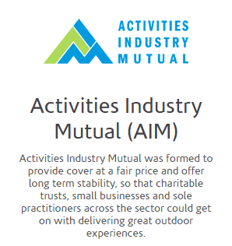
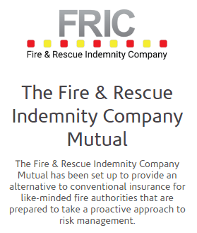
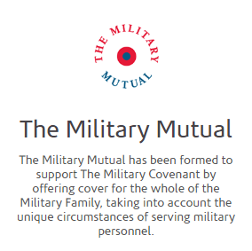
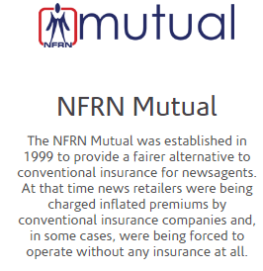
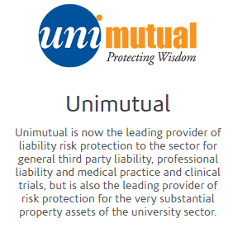
Examples of Discretionary Mutuals in the UK and Australia
19th Global
Conference of Actuaries
30th – 31st January, 2018 | Mumbai, India
A existing members club with 109,000 members who have recently agreed to create a discretionary mutual.

Slide 21
Lessons learnt from Discretionary Mutuals
19th Global
Conference of Actuaries
30th – 31st January, 2018 | Mumbai, India
DMs works when there is an organised group of members who are committed to manage risks to the benefit of the group. This works even better where the insurance industry does not understand the risks fully and quotes an unreasonable rate.
The absence of shareholders remove the potential Principle-Agent conundrum present in takaful.
Discretionary Mutual arrangements can do away with distribution costs as it can leverage off the existing network among its members.
The use of independent Mutual Management companies dispense with expensive investment in systems and people. The Management company is responsible for all aspects of administration for the Mutual.
Doing away with being labelled an insurer frees the Mutual from the need to hold solvency capital and reduces the cost of cover.

Slide 22
What can insurance learn from Takaful and Discretionary Mutuals?
19th Global
Conference of Actuaries
30th – 31st January, 2018 | Mumbai, India
Takaful and Discretionary Mutuals practice of sharing surpluses with its participants can, up to a point, align the interest of all stakeholders and encourage “good” behavior. For example, a premium discount on your motor policy if you do not make a claim in the year.
Requiring the insured to follow a mandated risk management process while being insured can reduce claims and thus premiums. Currently post underwriting the insured has no obligations to the insurer.
Less reliance on capital can also help reduce premiums. Regulator can reward good behavior by insurers by reducing the required solvency capital.
More use of Group type insurance through networks can reduce distribution costs. Experience refund for Group insurance allows the Group to reward all its members so that not only those who claim benefits from the cover.

Slide 23
Organizer
19th Global
Conference of Actuaries
30th – 31st January, 2018 | Mumbai, India
Thank You
Actuarial Partners Consulting Sdn Bhd www.actuarialpartners.com

